Slide 1

1151CS113-COMPUTER GRAPHICS AND IMAGE PROCESSING
SCHOOL OF COMPUTING
DEPARTMENT OF COMPUTER SCIENCE & ENGINEERING
UNIT-I
Faculty/ID – Raghavendran.S., M.E.,(PhD)/TTS1541
Assistant Professor

Slide 2
COMPUTER GRAPHICS AND IMAGE PROCESSING
Course Category: Program Core
Pre-requisite
Link to Other courses
Multimedia Systems
Computer Vision
SL.NO | Course Code | Course Name
1 | 1150MA103 | Engineering Mathematics 2
2 | 1150CS201 | Problem Solving using C

Slide 3
COMPUTER GRAPHICS AND IMAGE PROCESSING
Course Outcomes
CO Nos. | Course Outcomes | Level of learning domain (Based on revised Bloom’s taxonomy)
CO1 | Explain about basics of Computer Graphics | K2
CO2 | Summarize in the Shading models | K2
CO3 | Explain various Advance Modeling Techniques | K2
CO4 | Summarize in Basic of Image Processing | K2
CO5 | Explain various image restoration techniques | K3

Slide 4
UNIT-1
REVIEW OF GRAPHICS FUNDAMENTALS
Basic raster graphical algorithm for 2D primitives, Line drawing algorithm, Circle drawing algorithm, Ellipse drawing algorithm, 2D and 3D transformations; Window, Viewport, Clipping algorithm, Bezier curve, b-spline curve, surfaces and Solid modeling.
REFERENCES
Hearn & Baker, “Computer Graphics C version”, 2nd ed. Pearson Education, 2012.
www.slideshare.net/.../computer-graphics-image-processing-lecture-n.

Slide 5
INTRODUCTION
Computer graphics is an art of drawing pictures, lines, charts, etc using computers with the help of programming. Computer graphics is made up of number of pixels.
Image processing is a method to perform some operations on an image, in order to get an enhanced image or to extract some useful information from it.
Definition of Computer Graphics:
It is the use of computers to create and manipulate pictures on a display device. It comprises of software techniques to create, store, modify, represents pictures.

Slide 6
Application of Computer Graphics
Computer-Aided Design for engineering and architectural systems etc.
Presentation Graphics
Computer Art
Entertainment
Education and Training
Visualization
Image Processing
Graphical User Interface

Slide 7
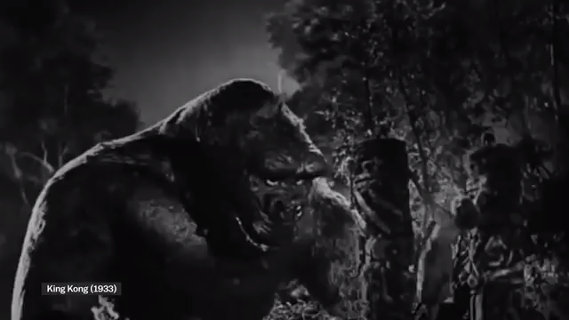
HOW COMPUTER GRAPHICS WORKS IN MOVIES??

Slide 8
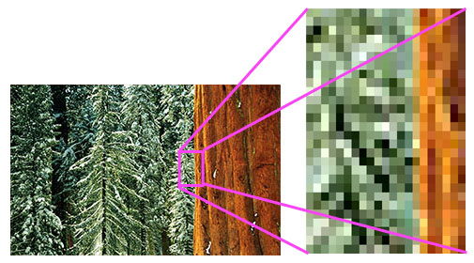
Pixel
Term that comes from the words PEL (picture element).
A px (pixel) is the smallest portion of an image or display that a computer is capable of printing or displaying.
You can get a better understanding of what a pixel is when zooming into an image as seen in the picture.
https://youtu.be/15aqFQQVBWU

Slide 9
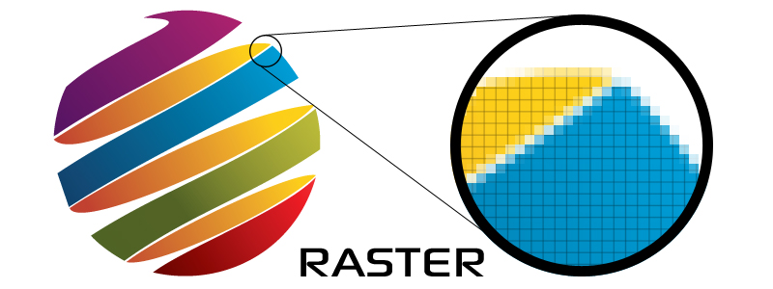
Raster Images
Computer graphics can be created as either raster or vector images. Raster graphics are bitmaps.
A bitmap is a grid of individual pixels that collectively compose an image.
Raster graphics render images as a collection of countless tiny squares.
Each square, or pixel, is coded in a specific hue or shade.
Individually, these pixels are worthless. Together, they’re worth a thousand words.

Slide 10


Vector Graphics
Vector graphics are based on mathematical formulas that define geometric primitives such as polygons, lines, curves, circles and rectangles.
Because vector graphics are composed of true geometric primitives, they are best used to represent more structured images, like line art graphics with flat, uniform colors.
Most created images (as opposed to natural images) meet these specifications, including logos, letterhead, and fonts.

Slide 11
Rasterisation
Rasterisation (or rasterization) is the task of taking an image described in a vector graphics format (shapes) and converting it into a raster image (a series of pixels, dots or lines, which, when displayed together, create the image which was represented via shapes).
The rasterised image may then be displayed on a computer display, video display or printer, or stored in a bitmap file format.
Rasterisation may refer to the technique of drawing 3D models, or the conversion of 2D rendering primitives such as polygons, line segments into a rasterized format

Slide 12
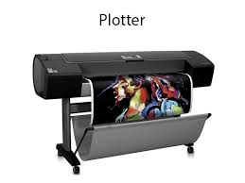
Basic raster graphical algorithm for 2D primitives
Idea is to approximate mathematical “ideal” primitives, described in Cartesian space, by sets of pixels on a raster display (bitmap in memory or frame buffer)
Fundamental algorithms for scan converting primitives to pixels, and clipping them
Many algorithms were initially designed for plotters
Can be implemented in hardware, software and Firmware

Slide 13
Primitives
lines
circles, arcs, ellipses
region filling
clipping
alphanumeric symbols – text
lines, circles, character generators (bitmaps), fonts
Want efficiency & speed (often drawing many primitives)

Slide 14
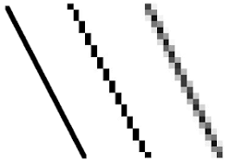
Scan Converting Lines
Assume that the line will be 1 pixel thick and will approximate an infinitely fine line
What properties should the line have?
slopes -1 to 1 = 1 pixel / column
otherwise 1 pixel / row
constant brightness (irrespective of length or orientation)
drawn as rapidly as possible
Other considerations:
pen style, line style, end point (rounded?),aliasing

Slide 15
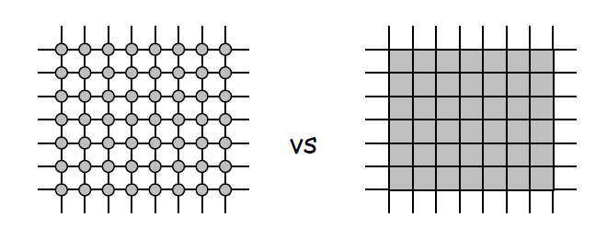
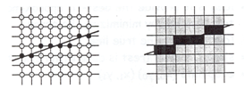
Assume (unless specified otherwise) that we will represent pixels as disjoint circles, centered on grid.
Idea is to compute the coordinates of a pixel that lies on or near an ideal, infinitely thin line imposed on a 2D raster grid.
For the algorithms discussed below, assume:
Integer coordinates of endpoints
Pixel on or off (2 states)
Slope |m| ≤ 1

Slide 16
Introduction to Line Drawing Algorithm
Line drawing on the computer means the computer screen is dividing into two parts rows and columns.
Those rows and columns are also known as Pixels.
In case we have to draw a line on the computer, first of all, we need to know which pixels should be on.
A line is a part of a straight line that extends in the opposite direction indefinitely.
The line is defined by two Endpoints. Its density should be separate from the length of the line.
The formula for a line interception of the slope:
Y = mx + b

Slide 17
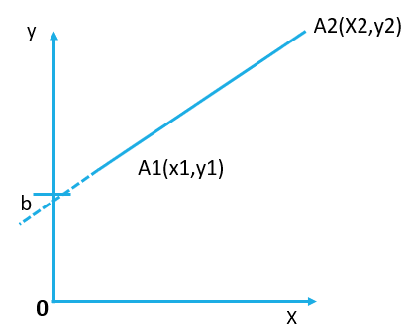
Introduction to Line Drawing Algorithm
In this formula, m is a line of the slope and b is intercept of y in the line. In positions (x1, y1) and (x2, y2), two endpoints are specified for the line segment.
The value of slope m and b can be determined accordingly • m = y2 – y1 / x2 – x1 • i.e. M = Δy / Δx

Slide 18
EXAMPLE
Line endpoints are (0,0) and (4,12). Plot the result to calculate each value of y as the x steps of 0 to 4.
Solution:
So we have a formula of equation of line:
Y = mx + b
m = y2 – y1 / x2 – x1 m = 12 – 0 / 4 – 0 m = 3
The y intercept b is then found by linking y1 and x1 to the y = 3 x + b formula, 0 = 3(0) + b.
Therefore, b = 0, so the y = 3x line formula.
The goal is to determine the next x, y location as quickly as possible by the previous one.

Slide 19
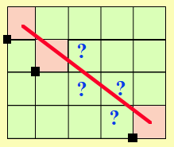
Line Drawing Algorithms
We are going to analyze how this process is achieved.
Some useful definitions General requirements
Rasterization:
Process of determining which pixels provide the best approximation to a desired line on the screen.
Scan Conversion:
Combination of rasterization and generating the picture in scan line order.
Straight lines must appear as straight lines.
They must start and end accurately
Lines should have constant brightness along their length
•Lines should drawn rapidly

Slide 20
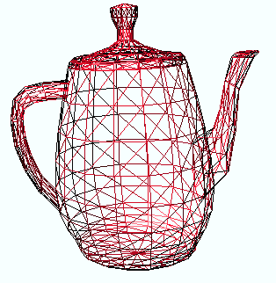
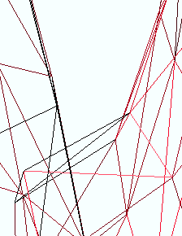
Line Drawing Algorithms
Three line drawing algorithms will be discussed below. They are:
1. Digital Differential Algorithm (DDA)
2. Midpoint Line Algorithm
3. Bresenham’s Line Algorithm
The lines of this object appear continuous
However, they are
made of pixels

Slide 21
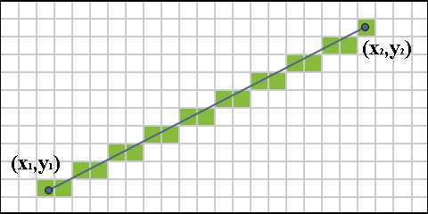
1. Digital Differential Algorithm ( DDA)
An incremental conversion method is a DDA Algorithm and also we called Digital Differential Algorithm (DDA).
Starting coordinates = (X0, Y0)
Ending coordinates = (Xn, Yn)
The points generation using DDA Algorithm involves the following steps-
Step-01:
Calculate ΔX, ΔY and M from the given input.
These parameters are calculated as-
ΔX = Xn – X0
ΔY =Yn – Y0
M = ΔY / ΔX

Slide 22
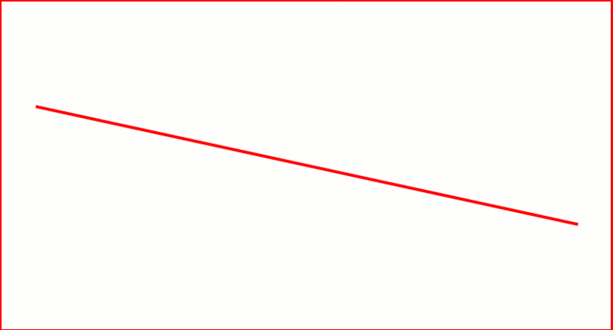
1. Digital Differential Algorithm ( DDA)
Step-02:
Find the number of steps or points in between the starting and ending coordinates.
if (absolute (ΔX) > absolute (ΔY))
Steps = absolute (ΔX);
else
Steps = absolute (ΔY);

Slide 23
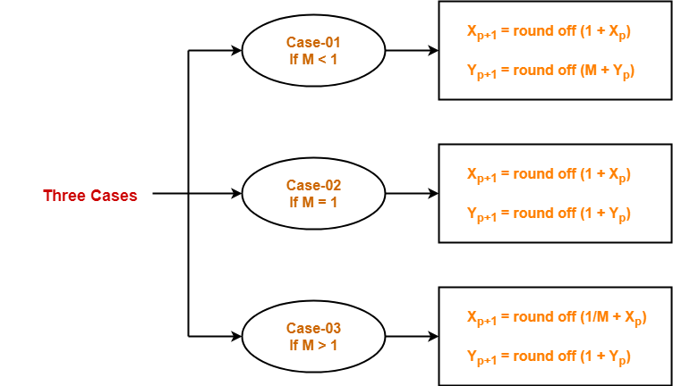
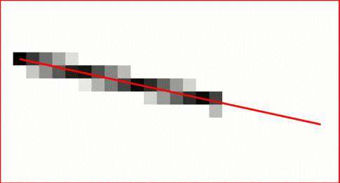
1. Digital Differential Algorithm ( DDA)
Step-03:
Suppose the current point is (X_{p}, Y_{p}) and the next point is (X_{p+1}, Y_{p+1}).
Find the next point by following the below three cases-

Slide 24
1. Digital Differential Algorithm ( DDA)
Step-04:
Keep repeating Step-03 until the end point is reached or the number of generated new points (including the starting and ending points) equals to the steps count.
PRACTICE PROBLEMS BASED ON DDA ALGORITHM-
Problem-01:
Calculate the points between the starting point (5, 6) and ending point (8, 12).
Solution-
Given-
Starting coordinates = (X0, Y0) = (5, 6)
Ending coordinates = (Xn, Yn) = (8, 12)

Slide 25
1. Digital Differential Algorithm ( DDA)
Step-01:
Calculate ΔX, ΔY and M from the given input.
ΔX = X_{n} – X₀ = 8 – 5 = 3
ΔY =Y_{n} – Y₀ = 12 – 6 = 6
M = ΔY / ΔX = 6 / 3 = 2
Step-02:
Calculate the number of steps.
As |ΔX| < |ΔY| = 3 < 6, so number of steps = ΔY = 6

Slide 26
1. Digital Differential Algorithm ( DDA)
Step-03:
As M > 1, so case-03 is satisfied.
Now, Step-03 is executed until Step-04 is satisfied.
X_{p} | Y_{p} | X_{p+1} | Y_{p+1} | Round off (X_{p+1}, Y_{p+1})
5 | 6 | 5.5 | 7 | (6, 7)
 |  | 6 | 8 | (6, 8)
 |  | 6.5 | 9 | (7, 9)
 |  | 7 | 10 | (7, 10)
 |  | 7.5 | 11 | (8, 11)
 |  | 8 | 12 | (8, 12)

Slide 27
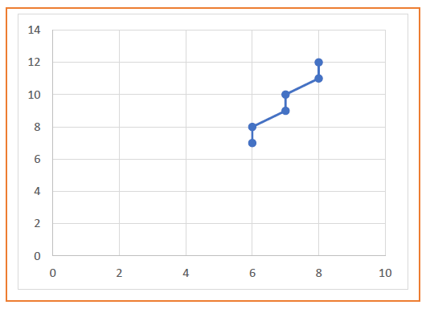
1. Digital Differential Algorithm ( DDA)

Slide 28
1. Digital Differential Algorithm ( DDA)
Problem-02:
Calculate the points between the starting point (5, 6) and ending point (13, 10).
Solution-
Given-
Starting coordinates = (X₀, Y₀) = (5, 6)
Ending coordinates = (X_{n}, Y_{n}) = (13, 10)
Step-01:
Calculate ΔX, ΔY and M from the given input.
ΔX = X_{n} – X₀ = 13 – 5 = 8
ΔY =Y_{n} – Y₀ = 10 – 6 = 4
M = ΔY / ΔX = 4 / 8 = 0.50
Step-02:
Calculate the number of steps.
As |ΔX| > |ΔY| = 8 > 4, so number of steps = ΔX = 8

Slide 29
1. Digital Differential Algorithm ( DDA)
Step-03:
As M < 1, so case-01 is satisfied.
Now, Step-03 is executed until Step-04 is satisfied.
X_{p} | Y_{p} | X_{p+1} | Y_{p+1} | Round off (X_{p+1}, Y_{p+1})
5 | 6 | 6 | 6.5 | (6, 7)
 |  | 7 | 7 | (7, 7)
 |  | 8 | 7.5 | (8, 8)
 |  | 9 | 8 | (9, 8)
 |  | 10 | 8.5 | (10, 9)
 |  | 11 | 9 | (11, 9)
 |  | 12 | 9.5 | (12, 10)
 |  | 13 | 10 | (13, 10)

Slide 30
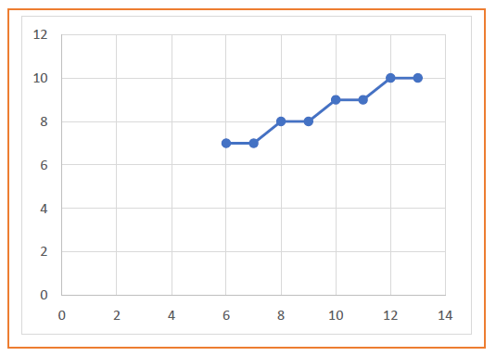
1. Digital Differential Algorithm ( DDA)

Slide 31
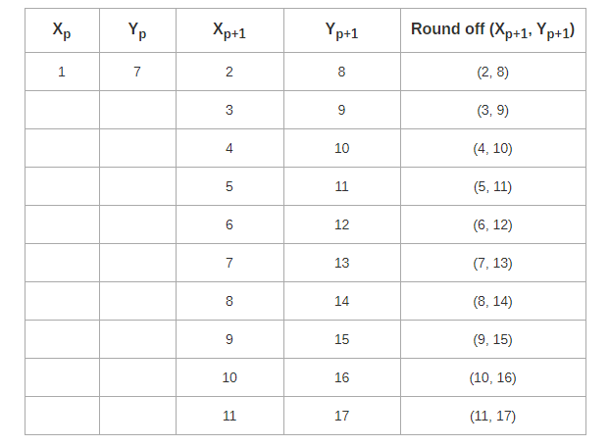
1. Digital Differential Algorithm ( DDA)
Problem-03:
Calculate the points between the starting point (1, 7) and ending point (11, 17).

Slide 32
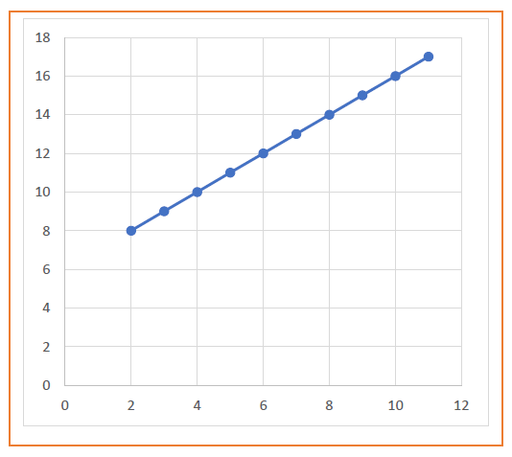
1. Digital Differential Algorithm ( DDA)

Slide 33
1. Digital Differential Algorithm ( DDA)
Advantages of DDA Algorithm-
It is a simple algorithm.
It is easy to implement.
It avoids using the multiplication operation which is costly in terms of time complexity.
Disadvantages of DDA Algorithm-
There is an extra overhead of using round off( ) function.
Using round off( ) function increases time complexity of the algorithm.
Resulted lines are not smooth because of round off( ) function.
The points generated by this algorithm are not accurate.

Slide 34
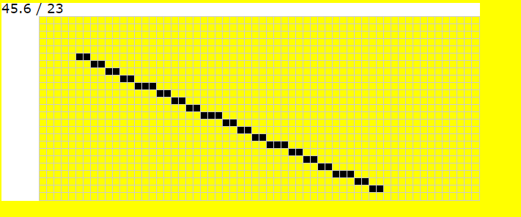
2.Bresenham Line Drawing Algorithm
Given the starting and ending coordinates of a line, Bresenham Line Drawing Algorithm attempts to generate the points between the starting and ending coordinates.
Given-
Starting coordinates = (X₀, Y₀)
Ending coordinates = (X_{n}, Y_{n})
The points generation using Bresenham Line Drawing Algorithm involves the following steps-
Step-01:
Calculate ΔX and ΔY from the given input.
These parameters are calculated as-
ΔX = X_{n} – X₀
ΔY =Y_{n} – Y₀

Slide 35
2.Bresenham Line Drawing Algorithm
Step-02:
Calculate the decision parameter P_{k}.
It is calculated as-
P_{k} = 2ΔY – ΔX
Step-03:
Suppose the current point is (X_{k}, Y_{k}) and the next point is (X_{k+1}, Y_{k+1}).
Find the next point depending on the value of decision parameter P_{k}.
Follow the below two cases-

Slide 36
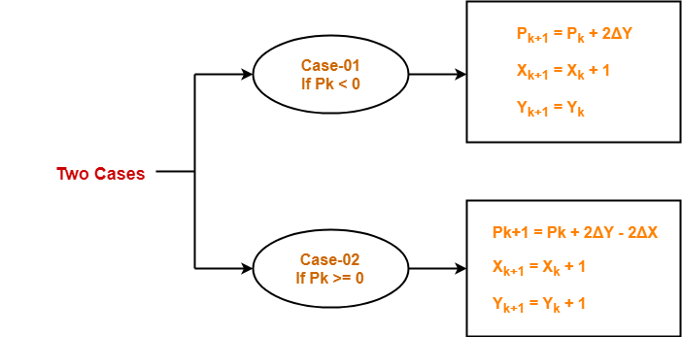
2.Bresenham Line Drawing Algorithm
Step-04:
Keep repeating Step-03 until the end point is reached or number of iterations equals to (ΔX-1) times.

Slide 37
2.Bresenham Line Drawing Algorithm
PRACTICE PROBLEMS BASED ON BRESENHAM LINE DRAWING ALGORITHM-
Problem-01:
Calculate the points between the starting coordinates (9, 18) and ending coordinates (14, 22).
Solution-
Given-
Starting coordinates = (X₀, Y₀) = (9, 18)
Ending coordinates = (X_{n}, Y_{n}) = (14, 22)

Slide 38
2.Bresenham Line Drawing Algorithm
Step-01:
Calculate ΔX and ΔY from the given input.
ΔX = X_{n} – X₀ = 14 – 9 = 5
ΔY =Y_{n} – Y₀ = 22 – 18 = 4
Step-02:
Calculate the decision parameter.
P_{k}
= 2ΔY – ΔX
= 2 x 4 – 5
= 3 So, decision parameter P_{k} = 3

Slide 39
2.Bresenham Line Drawing Algorithm
Step-03:
As P_{k} >= 0, so case-02 is satisfied.
Thus,
P_{k+1} = P_{k} + 2ΔY – 2ΔX = 3 + (2 x 4) – (2 x 5) = 1
X_{k+1} = X_{k} + 1 = 9 + 1 = 10
Y_{k+1} = Y_{k} + 1 = 18 + 1 = 19
Similarly, Step-03 is executed until the end point is reached or number of iterations equals to 4 times.
(Number of iterations = ΔX – 1 = 5 – 1 = 4)

Slide 40
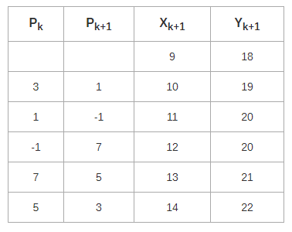
2.Bresenham Line Drawing Algorithm

Slide 41
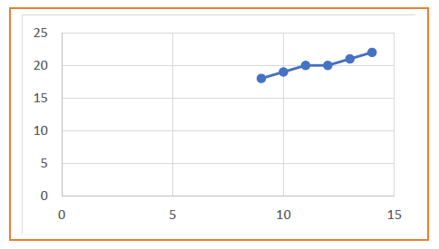
2.Bresenham Line Drawing Algorithm

Slide 42
2.Bresenham Line Drawing Algorithm
Problem-02:
Calculate the points between the starting coordinates (20, 10) and ending coordinates (30, 18).
Solution-
Given-
Starting coordinates = (X₀, Y₀) = (20, 10)
Ending coordinates = (X_{n}, Y_{n}) = (30, 18)
Step-01:
Calculate ΔX and ΔY from the given input.
ΔX = X_{n} – X₀ = 30 – 20 = 10
ΔY =Y_{n} – Y₀ = 18 – 10 = 8

Slide 43
2.Bresenham Line Drawing Algorithm
Step-02:
Calculate the decision parameter. P_{k}
= 2ΔY – ΔX
= 2 x 8 – 10= 6
So, decision parameter P_{k} = 6
Step-03:
As P_{k} >= 0, so case-02 is satisfied. Thus,
P_{k+1} = P_{k} + 2ΔY – 2ΔX = 6 + (2 x 8) – (2 x 10) = 2
X_{k+1} = X_{k} + 1 = 20 + 1 = 21
Y_{k+1} = Y_{k} + 1 = 10 + 1 = 11

Slide 44
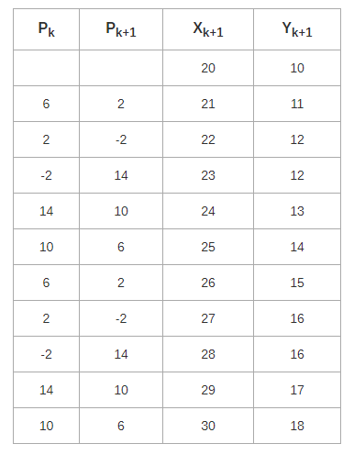
2.Bresenham Line Drawing Algorithm
Similarly, Step-03 is executed until the end point is reached or number of iterations equals to 9 times.(Number of iterations = ΔX – 1 = 10 – 1 = 9)

Slide 45
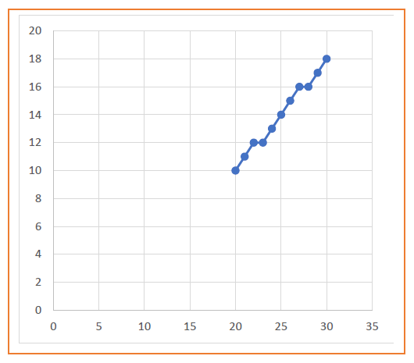
2.Bresenham Line Drawing Algorithm

Slide 46
2.Bresenham Line Drawing Algorithm
Advantages of Bresenham Line Drawing Algorithm-
The advantages of Bresenham Line Drawing Algorithm are-
It is easy to implement.
It is fast and incremental.
It executes fast but less faster than DDA Algorithm.
The points generated by this algorithm are more accurate than DDA Algorithm.
It uses fixed points only.

Slide 47
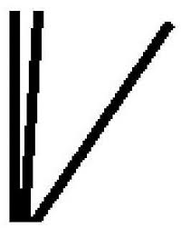
2.Bresenham Line Drawing Algorithm
Disadvantages of Bresenham Line Drawing Algorithm-
The disadvantages of Bresenham Line Drawing Algorithm are-
Though it improves the accuracy of generated points but still the resulted line is not smooth.
This algorithm is for the basic line drawing.
It can not handle diminishing jaggies.

Slide 48
3.MidPoint Line Drawing Algorithm
Given the starting and ending coordinates of a line, Mid Point Line Drawing Algorithm attempts to generate the points between the starting and ending coordinates.
Given-
Starting coordinates = (X₀, Y₀)
Ending coordinates = (X_{n}, Y_{n})
The points generation using Mid Point Line Drawing Algorithm involves the following steps-
Step-01:
Calculate ΔX and ΔY from the given input.
These parameters are calculated as-
ΔX = X_{n} – X₀
ΔY =Y_{n} – Y₀

Slide 49
3.MidPoint Line Drawing Algorithm
Step-02:
Calculate the value of initial decision parameter and ΔD.
These parameters are calculated as-
D_{initial} = 2ΔY – ΔX
ΔD = 2(ΔY – ΔX)
Step-03:
The decision whether to increment X or Y coordinate depends upon the flowing values of D_{initial}.
Follow the below two cases-

Slide 50
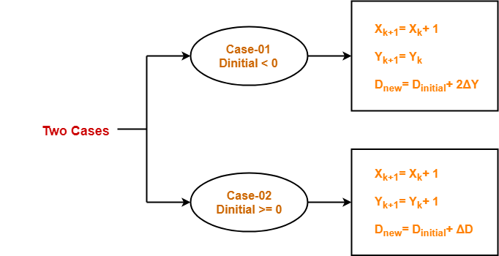
3.MidPoint Line Drawing Algorithm
Step-04:
Keep repeating Step-03 until the end point is reached.
For each D_{new} value, follow the above cases to find the next coordinates.

Slide 51
3.MidPoint Line Drawing Algorithm
PRACTICE PROBLEMS BASED ON MID POINT LINE DRAWING ALGORITHM-
Problem-01:
Calculate the points between the starting coordinates (20, 10) and ending coordinates (30, 18).
Solution-
Given-
Starting coordinates = (X₀, Y₀) = (20, 10)
Ending coordinates = (X_{n}, Y_{n}) = (30, 18)

Slide 52
3.MidPoint Line Drawing Algorithm
Step-01:
Calculate ΔX and ΔY from the given input.
ΔX = X_{n} – X₀ = 30 – 20 = 10
ΔY =Y_{n} – Y₀ = 18 – 10 = 8
Step-02:
Calculate D_{initial} and ΔD as-
D_{initial} = 2ΔY – ΔX = 2 x 8 – 10 = 6
ΔD = 2(ΔY – ΔX) = 2 x (8 – 10) = -4

Slide 53
3.MidPoint Line Drawing Algorithm
Step-03:
As D_{initial} >= 0, so case-02 is satisfied.
Thus,
X_{k+1} = X_{k} + 1 = 20 + 1 = 21
Y_{k+1} = Y_{k} + 1 = 10 + 1 = 11
D_{new} = D_{initial} + ΔD = 6 + (-4) = 2

Slide 54
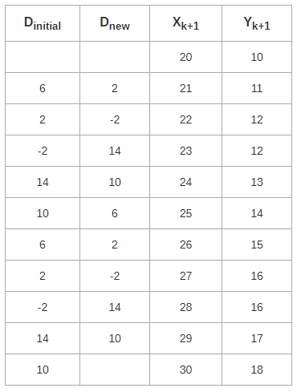
3.MidPoint Line Drawing Algorithm
Similarly, Step-03 is executed until the end point is reached.

Slide 55
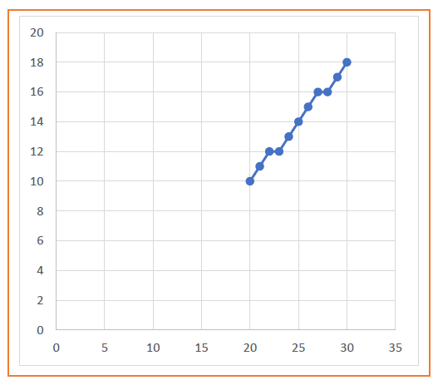
3.MidPoint Line Drawing Algorithm

Slide 56
3.MidPoint Line Drawing Algorithm
Problem-02:
Calculate the points between the starting coordinates (5, 9) and ending coordinates (12, 16).
Solution-
Given-
Starting coordinates = (X₀, Y₀) = (5, 9)
Ending coordinates = (X_{n}, Y_{n}) = (12, 16)
Step-01:
Calculate ΔX and ΔY from the given input.
ΔX = X_{n} – X₀ = 12 – 5 = 7
ΔY =Y_{n} – Y₀ = 16 – 9 = 7

Slide 57
3.MidPoint Line Drawing Algorithm
Step-02:
Calculate D_{initial} and ΔD as-
D_{initial} = 2ΔY – ΔX = 2 x 7 – 7 = 7
ΔD = 2(ΔY – ΔX) = 2 x (7 – 7) = 0
Step-03:
As D_{initial} >= 0, so case-02 is satisfied.
Thus,
X_{k+1} = X_{k} + 1 = 5 + 1 = 6
Y_{k+1} = Y_{k} + 1 = 9 + 1 = 10
D_{new} = D_{initial} + ΔD = 7 + 0 = 7

Slide 58
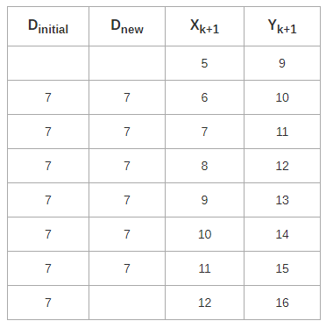
3.MidPoint Line Drawing Algorithm
Similarly, Step-03 is executed until the end point is reached.

Slide 59
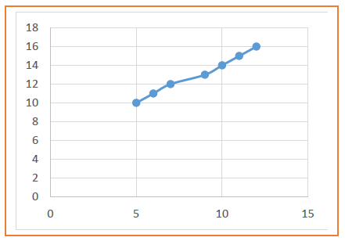
3.MidPoint Line Drawing Algorithm

Slide 60
3.MidPoint Line Drawing Algorithm
Advantages of Mid Point Line Drawing Algorithm-
The advantages of Mid Point Line Drawing Algorithm are-
Accuracy of finding points is a key feature of this algorithm.
It is simple to implement.
It uses basic arithmetic operations.
It takes less time for computation.
The resulted line is smooth as compared to other line drawing algorithms.

Slide 61
3.MidPoint Line Drawing Algorithm
Disadvantages of Mid Point Line Drawing Algorithm-
The disadvantages of Mid Point Line Drawing Algorithm are-
This algorithm may not be an ideal choice for complex graphics and images.
In terms of accuracy of finding points, improvement is still needed.
There is no any remarkable improvement made by this algorithm.

Slide 62
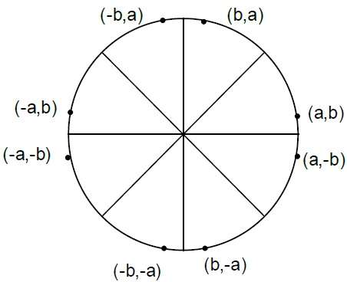
Circle Drawing Algorithm
It is not easy to display a continuous smooth arc on the computer screen as our computer screen is made of pixels organized in matrix form.
So, to draw a circle on a computer screen we should always choose the nearest pixels from a printed pixel so as they could form an arc.
There are two algorithm to do this:
Mid-Point circle drawing algorithm
Bresenham’s circle drawing algorithm

Slide 63
Midpoint Circle Drawing Algorithm
The midpoint circle drawing algorithm helps us to calculate the complete perimeter points of a circle for the first octant.
We can quickly find and calculate the points of other octants with the help of the first octant points.
The remaining points are the mirror reflection of the first octant points
In this algorithm, we define the unit interval and consider the nearest point of the circle boundary in each step.
Let us assume we have a point a (p, q) on the boundary of the circle and with r radius satisfying the equation fc (p, q) = 0

Slide 64
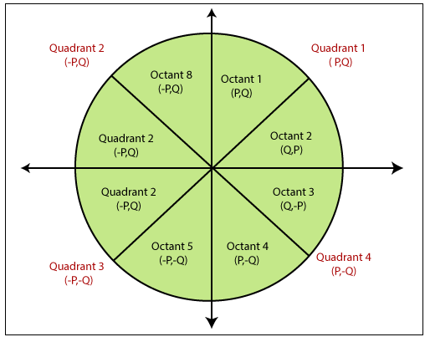
Midpoint Circle Drawing Algorithm
The equation of the circle is
f_{c} (p, q) = p² + q² = r² …………………………… (1)

Slide 65
Midpoint Circle Drawing Algorithm
If
f_{c} (p, q) < 0
then
The point is inside the circle boundary.
If
f_{c} (p, q) = 0
then
The point is on the circle boundary.
If
f_{c} (p, q) > 0
then
The point is outside the circle boundary.

Slide 66
Midpoint Circle Drawing Algorithm
Given-
Centre point of Circle = (X₀, Y₀)
Radius of Circle = R
The points generation using Mid Point Circle Drawing Algorithm involves the following steps-
Step-01:
Assign the starting point coordinates (X₀, Y₀) as-
X₀ = 0
Y₀ = R

Slide 67
Midpoint Circle Drawing Algorithm
Step-02:
Calculate the value of initial decision parameter P_{K} as-
P_{K} = 1 – R
Step-03:
Suppose the current point is (X_{k}, Y_{k}) and the next point is (X_{k+1}, Y_{k+1}).
Find the next point of the first octant depending on the value of decision parameter Pk.

Slide 68
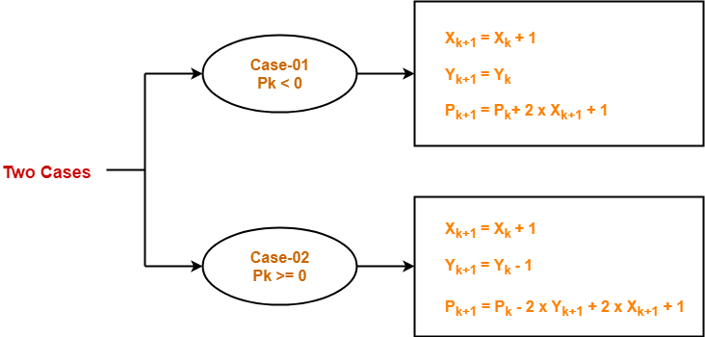
Midpoint Circle Drawing Algorithm
Follow the below two cases-

Slide 69
Midpoint Circle Drawing Algorithm
Step-04:
If the given centre point (X₀, Y₀) is not (0, 0), then do the following and plot the point-
X_{plot} = X_{c} + X₀
Y_{plot} = Y_{c} + Y₀
Here, (X_{c}, Y_{c}) denotes the current value of X and Y coordinates.
Step-05:
Keep repeating Step-03 and Step-04 until X_{plot} >= Y_{plot}.

Slide 70
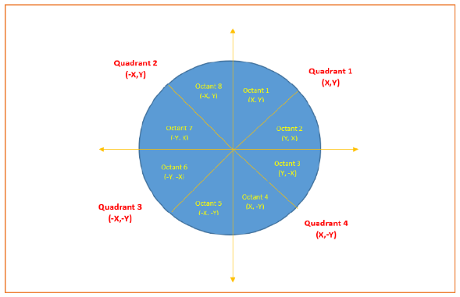
Midpoint Circle Drawing Algorithm
Step-06:
Step-05 generates all the points for one octant.
To find the points for other seven octants, follow the eight symmetry property of circle.
This is depicted by the following figure-

Slide 71
Midpoint Circle Drawing Algorithm
PRACTICE PROBLEMS BASED ON MID POINT CIRCLE DRAWING ALGORITHM
Problem-01:
Given the centre point coordinates (0, 0) and radius as 10, generate all the points to form a circle.
Solution-
Given-
Centre Coordinates of Circle (X₀, Y₀) = (0, 0)
Radius of Circle = 10

Slide 72
Midpoint Circle Drawing Algorithm
Step-01:
Assign the starting point coordinates (X₀, Y₀) as-
X₀ = 0
Y₀ = R = 10
Step-02:
Calculate the value of initial decision parameter PK as-
PK = 1 – R
PK = 1 – 10
PK = -9

Slide 73
Midpoint Circle Drawing Algorithm
Step-03:
As P_{initial} < 0, so case-01 is satisfied.
Thus,
X_{k+1} = X_{k} + 1 = 0 + 1 = 1
Y_{k+1} = Y_{k} = 10
P_{k+1} = P_{k} + 2 x X_{k+1} + 1 = -9 + (2 x 1) + 1 = -6
Step-04:
This step is not applicable here as the given centre point coordinates is (0, 0).

Slide 74
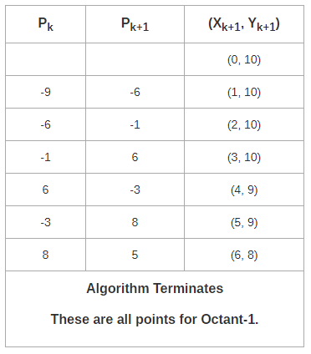
Midpoint Circle Drawing Algorithm
Step-05:
Step-03 is executed similarly until X_{k+1} >= Y_{k+1} as follows-

Slide 75
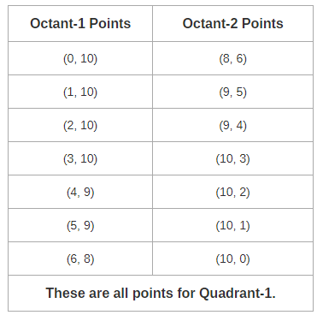
Midpoint Circle Drawing Algorithm
Algorithm calculates all the points of octant-1 and terminates.
Now, the points of octant-2 are obtained using the mirror effect by swapping X and Y coordinates.

Slide 76
Midpoint Circle Drawing Algorithm
Now, the points for rest of the part are generated by following the signs of other quadrants.
The other points can also be generated by calculating each octant separately.
Here, all the points have been generated with respect to quadrant-1-

Slide 77
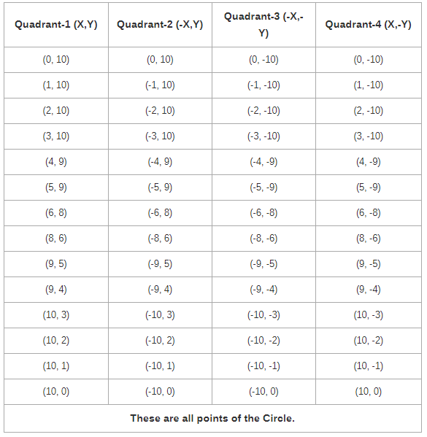
Midpoint Circle Drawing Algorithm

Slide 78
Midpoint Circle Drawing Algorithm
Advantages of Midpoint circle drawing algorithm
It is a powerful and efficient algorithm.
The midpoint circle drawing algorithm is easy to implement.
It is also an algorithm based on a simple circle equation (x² + y² = r²).
This algorithm helps to create curves on a raster display.
Disadvantages of Midpoint circle drawing algorithm
It is a time-consuming algorithm.
Sometimes the points of the circle are not accurate.

Slide 79
Bresenham’s circle drawing algorithm
Bresenham’s algorithm is also used for circle drawing. It is known as Bresenhams’s circle drawing algorithm.
It helps us to draw a circle. The circle generation is more complicated than drawing a line.
In this algorithm, we will select the closest pixel position to complete the arc. We cannot represent the continuous arc in the raster display system.
The different part of this algorithm is that we only use arithmetic integer. We can perform the calculation faster than other algorithms.

Slide 80
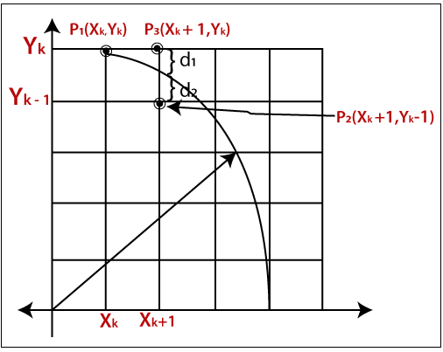
Bresenham’s circle drawing algorithm
Let us assume we have a point p (x, y) on the boundary of the circle and with r radius satisfying the equation f_{c} (x, y) = 0

Slide 81
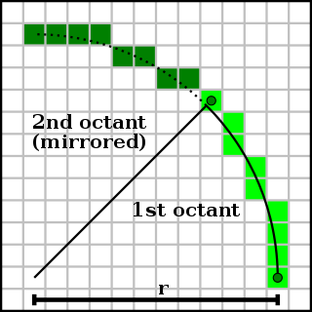
Bresenham’s circle drawing algorithm
As we know the equation of the circle is –
f_{c} (x, y) = x² + y² = r²
If f_{c} (x, y) < 0
then The point is inside the circle boundary.
If f_{c} (x, y) = 0
then The point is on the circle boundary.
If f_{c} (x, y) > 0
then The point is outside the circle boundary.

Slide 82
Bresenham’s circle drawing algorithm
Procedure-
Given-
Centre point of Circle = (X₀, Y₀)
Radius of Circle = R
The points generation using Bresenham Circle Drawing Algorithm involves the following steps-
Step-01:
Assign the starting point coordinates (X₀, Y₀) as-
X₀ = 0
Y₀ = R

Slide 83
Bresenham’s circle drawing algorithm
Step-02:
Calculate the value of initial decision parameter P_{k} as-
P_{K}= 3 – 2 x R
Step-03:
Suppose the current point is (X_{k}, Y_{k}) and the next point is (X_{k+1}, Y_{k+1}).
Find the next point of the first octant depending on the value of decision parameter P_{k}.

Slide 84
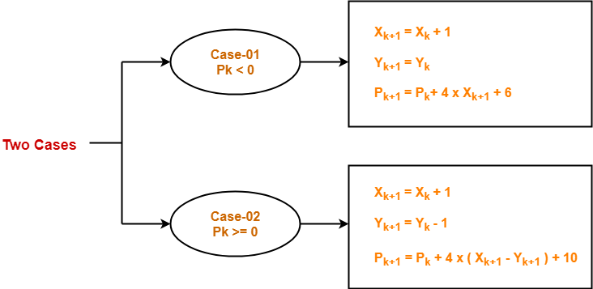
Bresenham’s circle drawing algorithm
Follow the below two cases-

Slide 85
Bresenham’s circle drawing algorithm
Step-04:
If the given centre point (X₀, Y₀) is not (0, 0), then do the following and plot the point-
X_{plot} = X_{c} + X₀
Y_{plot} = Y_{c} + Y₀
Here, (X_{c}, Y_{c}) denotes the current value of X and Y coordinates.
Step-05:
Keep repeating Step-03 and Step-04 until X_{plot} => Y_{plot}.

Slide 86
Bresenham’s circle drawing algorithm
Step-06:
Step-05 generates all the points for one octant.
To find the points for other seven octants, follow the eight symmetry property of circle.
This is depicted by the following figure-

Slide 87
Bresenham’s circle drawing algorithm
PRACTICE PROBLEMS BASED ON BRESENHAM CIRCLE DRAWING ALGORITHM
Problem-01:
Given the centre point coordinates (0, 0) and radius as 8, generate all the points to form a circle.
Solution-
Given-
Centre Coordinates of Circle (X₀, Y₀) = (0, 0)
Radius of Circle = 8

Slide 88
Bresenham’s circle drawing algorithm
Step-01:
Assign the starting point coordinates (X₀, Y₀) as-
X₀ = 0
Y₀ = R = 8
Step-02:
Calculate the value of initial decision parameter P_{k} as-
P_{K} = 3 – 2 x R
P_{K}= 3 – 2 x 8
P_{K}= -13

Slide 89
Bresenham’s circle drawing algorithm
Step-03:
As P_{initial} < 0, so case-01 is satisfied.
Thus,
X_{k+1} = X_{k} + 1 = 0 + 1 = 1
Y_{k+1} = Y_{k} = 8
P_{k+1} = P_{k} + 4 x X_{k+1} + 6 = -13 + (4 x 1) + 6 = -3
Step-04:
This step is not applicable here as the given centre point coordinates is (0, 0).

Slide 90
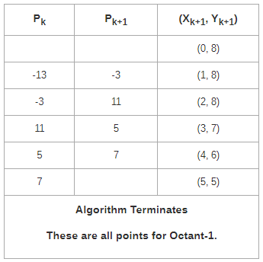
Bresenham’s circle drawing algorithm
Step-05:
Step-03 is executed similarly until X_{k+1} >= Y_{k+1} as follows-

Slide 91
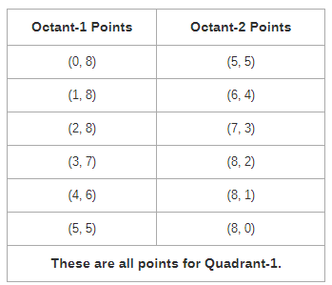
Bresenham’s circle drawing algorithm
Algorithm calculates all the points of octant-1 and terminates.
Now, the points of octant-2 are obtained using the mirror effect by swapping X and Y coordinates.

Slide 92
Bresenham’s circle drawing algorithm
Now, the points for rest of the part are generated by following the signs of other quadrants.
The other points can also be generated by calculating each octant separately.
Here, all the points have been generated with respect to quadrant-1-

Slide 93
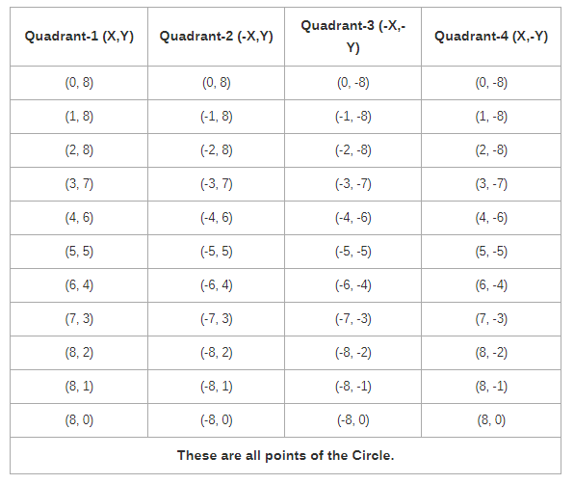
Bresenham’s circle drawing algorithm

Slide 94
Bresenham’s circle drawing algorithm
Advantages of Bresenham’s Circle Drawing Algorithm
It is simple and easy to implement.
The algorithm is based on simple equation x² + y² = r².
Disadvantages of Bresenham’s Circle Drawing Algorithm
The plotted points are less accurate than the midpoint circle drawing.
It is not so good for complex images and high graphics images.

Slide 95
Ellipse Drawing algorithm
An ellipse is an elongated circle. Therefore, elliptical curves can be generated by modifying circle-drawing procedures to take into account the different dimensions of an ellipse along the major and minor axes
Properties of Ellipses
An ellipse is defined as the set of points such that the sum of the distances from two fixed positions (foci) is the same for all points.
Ellipse generated about foci F1, and F2.

Slide 96
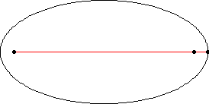
Ellipse Drawing algorithm
If the distances to the two foci from any point P = (x, y) on the ellipse are labeled dl and d2, then the general equation of an ellipse can be stated as
d1 + d2 = constant
Expressing distances d1 and d2 in terms of the focal coordinates F1= (x1, y1) and F2 = (x2, y2), we have

Slide 97
Ellipse Drawing algorithm
Equation simplified if ellipse axis parallel to coordinate axis
Parametric form

Slide 98
Ellipse Drawing algorithm
Symmetry Considerations
4-way symmetry
Unit steps in x until reach region boundary
Switch to unit steps in y
Step in x while
Switch to steps in y when

Slide 99
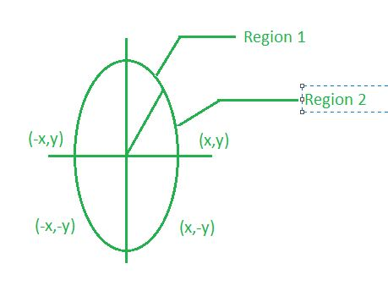
Mid-Point Ellipse Algorithm
Midpoint ellipse algorithm plots(finds) points of an ellipse on the first quadrant by dividing the quadrant into two regions.
Each point(x, y) is then projected into other three quadrants (-x, y), (x, -y),
(-x, -y) i.e. it uses 4-way symmetry.

Slide 100
Mid-Point Ellipse Algorithm
Function of ellipse:
f_{ellipse}(x, y)=x²b²+y²a² -a²b²
f_{ellipse}(x, y)<0 then (x, y) is inside the ellipse.
f_{ellipse}(x, y)>0 then (x, y) is outside the ellipse.
f_{ellipse}(x, y)=0 then (x, y) is on the ellipse.
Decision parameter:
Initially, we have two decision parameters p1_{k}in region 1 and p2_{k} in region 2.
These parameters are defined as : p1_{k} in region 1 is given as
p1_{k}=r_{y}²+1/4r_{x}²-r_{x}²r_{y}

Slide 101
Mid-Point Ellipse Algorithm
In this algorithm the ellipse will be drawn. The center of the ellipse will be (0,0).
To draw an ellipse, we solve the algorithm for the first quadrant.
Points on the other quadrant will be mirrored from the first quadrant.
The first quadrant has two regions.
If we draw a tangent at any point on the ellipse at region 1, the slope of the tangent must be m<1.
In the diagram the red tangent with slope <1
Similarly, if we draw a tangent on the ellipse at any point of region 2, the slope of the tangent must be greater than one (m>1). In the diagram blue tangent has a slope >1

Slide 102
Mid-Point Ellipse Algorithm
2nd Quadrant
1st Quadrant
Region 1
b
Region 2
a
3rd Quadrant
4th Quadrant

Slide 103
Mid-Point Ellipse Algorithm
The green tangent is separating each region. The slope of this tangent is m=-1
The equation of the ellipse is (x²/a²)+(y²/b²)=1 or x²b²+y²a² -a²b² =0=f(x,y)
We know the slope of the line is m=dy/dx
The partial derivative of f(x,y) w.r.t.x=fx=2xb²
The partial derivative of f(x,y) w.r.t.y=fy=2ya²
dy/dx = -(fx/fy)=(-2xb²/2ya²)
So when 2xb²>=2ya² calculation of region 1 stopped and calculation of region 2 starts

Slide 104
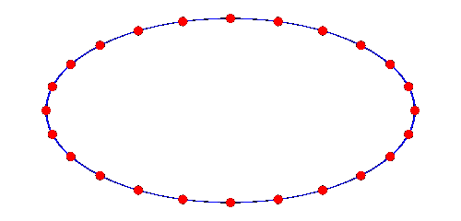
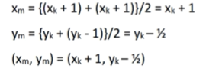
Mid-Point Ellipse Algorithm
Region 1
The slope of the tangent (m<1)
X value increases at the unit intervals so x_{k+1}= x_{k} +1
The y value will either y_{k} or y_{k}-1
So the next point will be either (x_{k}+1,y_{k})(x_{k}+1,y_{k}-1)
The mid point =(xm,ym)

Slide 105
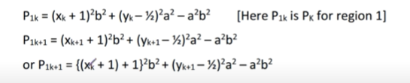
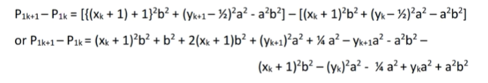
Putting the value of midpoint in the ellipse equation we get the decision parameter p1k
Now

Slide 106

Mid-Point Ellipse Algorithm
The Ellipse starts from (0,b), therefore putting (0,b) in P_{1k} we get ,
P_{1k} =(0+1)²b²+(b-1/2) ²a²-a²b²
Or
P_{1k} =b²+ b² a²+1/4a²-a²b- a²b²
or
P_{1k} =b²+1/4a²-a²b[initial decision parameter for first region]
Now, if P_{1k} =>=0 then the next coordinate is (x_{k}+1,y_{k}-1)
Else if P_{1k} <0 then the next coordinate is (x_{k}+1,y_{k})

Slide 107

Mid-Point Ellipse Algorithm
Region 2
The slope of the tangent (m>1)
y value decreases at the unit intervals so y_{k+1}= y_{k} -1
The x value will either xk or xk+1
So the next point will be either (x_{k},y_{k} -1) or (x_{k}+1,y_{k}-1)
The mid point =(xm,ym)

Slide 108


Mid-Point Ellipse Algorithm
Putting the value of midpoint in the ellipse equation we get the decision parameter P2k
Now

Slide 109

Mid-Point Ellipse Algorithm
The initial decision parameter value will be calculated after completing the first region
Now, if P_{2k} >0 then the next coordinate is (x_{k},y_{k}-1)
Else if P_{2k} <0 the the next coordinate is is (x_{k}+1,y_{k}-1)

Slide 110

2D and 3D Transformations
Transformations
Transformations are a fundamental part of the computer graphics. Transformations are the movement of the object in Cartesian plane .
Types of Transformation
There are two types of transformation in computer graphics.
2D transformation
3D transformation

Slide 111
2D and 3D Transformations
Types of 2D and 3D transformation
1) Translation
2) Rotation
3) Scaling
4) Shearing
5) Mirror reflection
Why we use Transformation ?
Transformation are used to position objects , to shape object , to change viewing positions , and even how something is viewed.
In simple words transformation is used for
1) Modeling
2) Viewing
https://www.mathwarehouse.com/animated-gifs/transformations.php

Slide 112
2D Transformation
When the transformation takes place on a 2D plane .it is called 2D transformation.
2D means two dimensional (x-axis and Y-axis
Object Transformation in 2D
Alter the coordinates descriptions an object
Translation , rotation , scaling , shearing, reflection.
Coordinate system unchanged
Coordinate transformation in 2D
Produce a different coordinate system

Slide 113
2D Translation is a process of moving an object from one
position to another in a two dimensional plane.
Let-
Initial coordinates of the object O = (X_{old}, Y_{old})
New coordinates of the object O after translation = (X_{new}, Y_{new})
Translation vector or Shift vector = (T_{x}, T_{y})
Given a Translation vector (T_{x}, T_{y})-
T_{x} defines the distance the X_{old} coordinate has to be moved.
T_{y} defines the distance the Y_{old} coordinate has to be moved.
2D Translation

Slide 114

2D Translation
2D Translation
This translation is achieved by adding the translation coordinates to the old coordinates of the object as
X_{new} = X_{old} + T_{x} (This denotes translation towards X axis)
Y_{new} = Y_{old} + T_{y} (This denotes translation towards Y axis)

Slide 115


2D Translation
In Matrix form, the above translation equations may be represented as
The homogeneous coordinates representation of (X, Y) is (X, Y, 1).
Through this representation, all the transformations can be performed using matrix / vector multiplications.
The above translation matrix may be represented as a 3 x 3 matrix as
https://www.mathwarehouse.com/animated-gifs/transformations.php#translations

Slide 116
PRACTICE PROBLEMS BASED ON 2D TRANSLATION
Given a circle C with radius 10 and center coordinates (1, 4). Apply the translation with distance 5 towards X axis and 1 towards Y axis. Obtain the new coordinates of C without changing its radius.
Solution-
Given-
Old center coordinates of C = (X_{old}, Y_{old}) = (1, 4)
Translation vector = (T_{x}, T_{y}) = (5, 1)
Let the new center coordinates of C = (X_{new}, Y_{new}).
Applying the translation equations, we have-
X_{new} = X_{old} + T_{x} = 1 + 5 = 6
Y_{new} = Y_{old} + T_{y} = 4 + 1 = 5
Thus, New center coordinates of C = (6, 5).

Slide 117


PRACTICE PROBLEMS BASED ON 2D TRANSLATION
In matrix form, the new center coordinates of C after translation may be obtained as-
Thus, New center coordinates of C = (6, 5).

Slide 118
2D Rotation
Rotation is a process of rotating an object with respect to
an angle in a two dimensional plane.
Consider a point object O has to be rotated from one angle to another in a 2D plane.
Let-
Initial coordinates of the object O = (X_{old}, Y_{old})
Initial angle of the object O with respect to origin = Φ
Rotation angle = θ
New coordinates of the object O after rotation = (X_{new}, Y_{new})
https://www.mathwarehouse.com/animated-gifs/transformations.php#rotations

Slide 119


2D Rotation
This rotation is achieved by using the following rotation equations
X_{new} = X_{old} x cosθ – Y_{old} x sinθ
Y_{new} = X_{old} x sinθ + Y_{old} x cosθ
In Matrix form, the above rotation equations may be represented as

Slide 120
PRACTICE PROBLEMS BASED ON 2D ROTATION
Given a line segment with starting point as (0, 0) and ending point as
(4, 4). Apply 30 degree rotation anticlockwise direction on the line segment and find out the new coordinates of the line.
Solution-
We rotate a straight line by its end points with the same angle. Then, we re-draw a line between the new end points.
Given-
Old ending coordinates of the line = (X_{old}, Y_{old}) = (4, 4)
Rotation angle = θ = 30º
Let new ending coordinates of the line after rotation = (X_{new}, Y_{new}).

Slide 121
PRACTICE PROBLEMS BASED ON 2D ROTATION
Applying the rotation equations, we have
X_{new} = X_{old} x cosθ – Y_{old} x sinθ
= 4 x cos30º – 4 x sin30º
= 4 x (√3 / 2) – 4 x (1 / 2)
= 2√3 – 2
= 2(√3 – 1)
= 2(1.73 – 1)
= 1.46
Y_{new} = X_{old} x sinθ + Y_{old} x cosθ
= 4 x sin30º + 4 x cos30º
= 4 x (1 / 2) + 4 x (√3 / 2)
= 2 + 2√3
= 2(1 + √3)
= 2(1 + 1.73)
= 5.46
Thus, New ending coordinates of the line after rotation = (1.46, 5.46).

Slide 122


PRACTICE PROBLEMS BASED ON 2D ROTATION
In matrix form, the new ending coordinates of the line after rotation may
be obtained as-
Thus, New ending coordinates of the line after rotation = (1.46, 5.46).

Slide 123
2D Scaling
Scaling is a process of modifying or altering the size of objects.
Scaling may be used to increase or reduce the size of object.
Scaling subjects the coordinate points of the original object to change.
Scaling factor determines whether the object size is to be increased or reduced.
If scaling factor > 1, then the object size is increased.
If scaling factor < 1, then the object size is reduce

Slide 124
2D Scaling
Consider a point object O has to be scaled in a 2D plane.
Let-
Initial coordinates of the object O = (X_{old}, Y_{old})
Scaling factor for X-axis = S_{x}
Scaling factor for Y-axis = S_{y}
New coordinates of the object O after scaling = (X_{new}, Y_{new})
This scaling is achieved by using the following scaling equations
X_{new} = X_{old} x S_{x}
Y_{new} = Y_{old} x S_{y}

Slide 125


2D Scaling
In Matrix form, the above scaling equations may be represented as
For homogeneous coordinates, the above scaling matrix may be represented as a 3 x 3 matrix as

Slide 126
PRACTICE PROBLEMS BASED ON 2D SCALING
Given a square object with coordinate points A(0, 3), B(3, 3), C(3, 0), D(0, 0). Apply the scaling parameter 2 towards X axis and 3 towards Y axis and obtain the new coordinates of the object.
Solution-
Given-
Old corner coordinates of the square = A (0, 3), B(3, 3), C(3, 0), D(0, 0)
Scaling factor along X axis = 2
Scaling factor along Y axis = 3

Slide 127
PRACTICE PROBLEMS BASED ON 2D SCALING
For Coordinates A(0, 3)
Let the new coordinates of corner A after scaling = (X_{new}, Y_{new}).
Applying the scaling equations, we have-
X_{new} = X_{old} x S_{x} = 0 x 2 = 0
Y_{new} = Y_{old} x S_{y} = 3 x 3 = 9
Thus, New coordinates of corner A after scaling = (0, 9).
For Coordinates B(3, 3)
Let the new coordinates of corner B after scaling = (Xnew, Ynew).
Applying the scaling equations, we have-
Xnew = Xold x Sx = 3 x 2 = 6
Ynew = Yold x Sy = 3 x 3 = 9
Thus, New coordinates of corner B after scaling = (6, 9).

Slide 128
PRACTICE PROBLEMS BASED ON 2D SCALING
For Coordinates C(3, 0)
Let the new coordinates of corner C after scaling = (X_{new}, Y_{new}).
Applying the scaling equations, we have-
X_{new} = X_{old} x S_{x} = 3 x 2 = 6
Y_{new} = Y_{old} x S_{y} = 0 x 3 = 0
Thus, New coordinates of corner C after scaling = (6, 0).
For Coordinates D(0, 0)
Let the new coordinates of corner D after scaling = (X_{new}, Y_{new}).
Applying the scaling equations, we have-
X_{new} = X_{old} x S_{x} = 0 x 2 = 0
Y_{new} = Y_{old} x S_{y} = 0 x 3 = 0
Thus, New coordinates of corner D after scaling = (0, 0).

Slide 129

PRACTICE PROBLEMS BASED ON 2D SCALING
Thus, New coordinates of the square after scaling = A (0, 9), B(6, 9), C(6, 0), D(0, 0).

Slide 130
2D Reflection
Reflection is a kind of rotation where the angle of rotation is 180 degree.
The reflected object is always formed on the other side of mirror.
The size of reflected object is same as the size of original object.
Consider a point object O has to be reflected in a 2D plane.
Let-
Initial coordinates of the object O = (X_{old}, Y_{old})
New coordinates of the reflected object O after reflection
= (X_{new}, Y_{new})

Slide 131


2D Reflection
Reflection On X-Axis:
This reflection is achieved by using the following reflection equations
X_{new} = X_{old}
Y_{new} = -Y_{old}
In Matrix form, the above reflection equations may be represented as-
For homogeneous coordinates, the above reflection matrix may be represented as a 3 x 3 matrix as

Slide 132


2D Reflection
Reflection On Y-Axis:
This reflection is achieved by using the following reflection equations-
X_{new} = -X_{old}
Y_{new} = Y_{old}
In Matrix form, the above reflection equations may be represented as
For homogeneous coordinates, the above reflection matrix may be represented as a 3 x 3 matrix as

Slide 133
PRACTICE PROBLEMS BASED ON 2D REFLECTION
Given a triangle with coordinate points A(3, 4), B(6, 4), C(5, 6). Apply the reflection on the X axis and obtain the new coordinates of the object.
Solution-
Given-
Old corner coordinates of the triangle = A (3, 4), B(6, 4), C(5, 6)
Reflection has to be taken on the X axis
For Coordinates A(3, 4)
Let the new coordinates of corner A after reflection = (X_{new}, Y_{new}).
Applying the reflection equations, we have-
X_{new} = X_{old} = 3
Y_{new} = -Y_{old} = -4
Thus, New coordinates of corner A after reflection = (3, -4).

Slide 134
PRACTICE PROBLEMS BASED ON 2D REFLECTION
For Coordinates B(6, 4)
Let the new coordinates of corner B after reflection = (X_{new}, Y_{new}).
Applying the reflection equations, we have-
X_{new} = X_{old} = 6
Y_{new} = -Y_{old} = -4
Thus, New coordinates of corner B after reflection = (6, -4).
For Coordinates C(5, 6)
Let the new coordinates of corner C after reflection = (X_{new}, Y_{new}).
Applying the reflection equations, we have-
X_{new} = X_{old} = 5
Y_{new} = -Y_{old} = -6
Thus, New coordinates of corner C after reflection = (5, -6).

Slide 135

PRACTICE PROBLEMS BASED ON 2D REFLECTION
Thus, New coordinates of the triangle after reflection =
A (3, -4), B(6, -4), C(5, -6).

Slide 136

2D Shearing
2D Shearing is an ideal technique to change the shape of an existing object in a two dimensional plane.
In a two dimensional plane, the object size can be changed along X direction as well as Y direction. So, there are two versions of shearing
Shearing in X direction
Shearing in Y direction
Consider a point object O has to be sheared in a 2D plane.
Let-
Initial coordinates of the object O = (X_{old}, Y_{old})
Shearing parameter towards X direction = Sh_{x}
Shearing parameter towards Y direction = Sh_{y}
New coordinates of the object O after shearing = (X_{new}, Y_{new})

Slide 137


2D Shearing
Shearing in X Axis-
Shearing in X axis is achieved by using the following shearing equations
X_{new} = X_{old} + Sh_{x} x Y_{old}
Y_{new} = Y_{old}
In Matrix form, the above shearing equations may be represented as
For homogeneous coordinates, the above shearing matrix may be represented as a 3 x 3 matrix as-

Slide 138


2D Shearing
Shearing in Y Axis-
Shearing in Y axis is achieved by using the following shearing equations
X_{new} = X_{old}
Y_{new} = Y_{old} + Sh_{y} x X_{old}
In Matrix form, the above shearing equations may be represented as-
For homogeneous coordinates, the above shearing matrix may be represented as a 3 x 3 matrix as

Slide 139
2D Shearing
PRACTICE PROBLEMS BASED ON 2D SHEARING IN COMPUTER GRAPHICS-
Problem-01:
Given a triangle with points (1, 1), (0, 0) and (1, 0). Apply shear parameter 2 on X axis and 2 on Y axis and find out the new coordinates of the object.
Solution-
Given-
Old corner coordinates of the triangle = A (1, 1), B(0, 0), C(1, 0)
Shearing parameter towards X direction (Sh_{x}) = 2
Shearing parameter towards Y direction (Sh_{y}) = 2

Slide 140
2D Shearing
Shearing in X Axis-
For Coordinates A(1, 1)
Let the new coordinates of corner A after shearing = (X_{new}, Y_{new}).
Applying the shearing equations, we have-
X_{new} = X_{old} + Sh_{x} x Y_{old} = 1 + 2 x 1 = 3
Y_{new} = Y_{old} = 1
Thus, New coordinates of corner A after shearing = (3, 1).

Slide 141
2D Shearing
For Coordinates B(0, 0)
Let the new coordinates of corner B after shearing = (X_{new}, Y_{new}).
Applying the shearing equations, we have-
X_{new} = X_{old} + Sh_{x} x Y_{old} = 0 + 2 x 0 = 0
Y_{new} = Y_{old} = 0
Thus, New coordinates of corner B after shearing = (0, 0).

Slide 142
2D Shearing
For Coordinates C(1, 0)
Let the new coordinates of corner C after shearing = (X_{new}, Y_{new}).
Applying the shearing equations, we have-
X_{new} = X_{old} + Sh_{x} x Y_{old} = 1 + 2 x 0 = 1
Y_{new} = Y_{old} = 0
Thus, New coordinates of corner C after shearing = (1, 0).
Thus, New coordinates of the triangle after shearing in X axis = A (3, 1),
B(0, 0), C(1, 0).

Slide 143
2D Shearing
Shearing in Y Axis-
For Coordinates A(1, 1)
Let the new coordinates of corner A after shearing = (X_{new}, Y_{new}).
Applying the shearing equations, we have-
X_{new} = X_{old} = 1
Y_{new} = Y_{old} + Sh_{y} x X_{old} = 1 + 2 x 1 = 3
Thus, New coordinates of corner A after shearing = (1, 3).

Slide 144
2D Shearing
For Coordinates B(0, 0)
Let the new coordinates of corner B after shearing = (X_{new}, Y_{new}).
Applying the shearing equations, we have-
X_{new} = X_{old} = 0
Y_{new} = Y_{old} + Sh_{y} x X_{old} = 0 + 2 x 0 = 0
Thus, New coordinates of corner B after shearing = (0, 0).

Slide 145
2D Shearing
For Coordinates C(1, 0)
Let the new coordinates of corner C after shearing = (X_{new}, Y_{new}).
Applying the shearing equations, we have-
X_{new} = X_{old} = 1
Y_{new} = Y_{old} + Sh_{y} x X_{old} = 0 + 2 x 1 = 2

Slide 146

2D Shearing
Thus, New coordinates of corner C after shearing = (1, 2).
Thus, New coordinates of the triangle after shearing in Y axis = A (1, 3), B(0, 0), C(1, 2).

Slide 147
2D Shearing
PRACTICE PROBLEMS BASED ON 2D SHEARING IN COMPUTER GRAPHICS-
Problem-01:
Given a triangle with points (1, 1), (0, 0) and (1, 0). Apply shear parameter 2 on X axis and 2 on Y axis and find out the new coordinates of the object.
Solution-
Given-
Old corner coordinates of the triangle = A (1, 1), B(0, 0), C(1, 0)
Shearing parameter towards X direction (Sh_{x}) = 2
Shearing parameter towards Y direction (Sh_{y}) = 2

Slide 148
2D Shearing
Shearing in X Axis-
For Coordinates A(1, 1)
Let the new coordinates of corner A after shearing = (X_{new}, Y_{new}).
Applying the shearing equations, we have-
X_{new} = X_{old} + Sh_{x} x Y_{old} = 1 + 2 x 1 = 3
Y_{new} = Y_{old} = 1
Thus, New coordinates of corner A after shearing = (3, 1).

Slide 149
2D Shearing
For Coordinates B(0, 0)
Let the new coordinates of corner B after shearing = (X_{new}, Y_{new}).
Applying the shearing equations, we have-
X_{new} = X_{old} + Sh_{x} x Y_{old} = 0 + 2 x 0 = 0
Y_{new} = Y_{old} = 0
Thus, New coordinates of corner B after shearing = (0, 0).

Slide 150
2D Shearing
For Coordinates C(1, 0)
Let the new coordinates of corner C after shearing = (X_{new}, Y_{new}).
Applying the shearing equations, we have-
X_{new} = X_{old} + Sh_{x} x Y_{old} = 1 + 2 x 0 = 1
Y_{new} = Y_{old} = 0
Thus, New coordinates of corner C after shearing = (1, 0).
Thus, New coordinates of the triangle after shearing in X axis = A (3, 1),
B(0, 0), C(1, 0).

Slide 151
2D Shearing
Shearing in Y Axis-
For Coordinates A(1, 1)
Let the new coordinates of corner A after shearing = (X_{new}, Y_{new}).
Applying the shearing equations, we have-
X_{new} = X_{old} = 1
Y_{new} = Y_{old} + Sh_{y} x X_{old} = 1 + 2 x 1 = 3
Thus, New coordinates of corner A after shearing = (1, 3).

Slide 152
2D Shearing
For Coordinates B(0, 0)
Let the new coordinates of corner B after shearing = (X_{new}, Y_{new}).
Applying the shearing equations, we have-
X_{new} = X_{old} = 0
Y_{new} = Y_{old} + Sh_{y} x X_{old} = 0 + 2 x 0 = 0
Thus, New coordinates of corner B after shearing = (0, 0).

Slide 153
2D Shearing
For Coordinates C(1, 0)
Let the new coordinates of corner C after shearing = (X_{new}, Y_{new}).
Applying the shearing equations, we have-
X_{new} = X_{old} = 1
Y_{new} = Y_{old} + Sh_{y} x X_{old} = 0 + 2 x 1 = 2

Slide 154
2D Shearing
Thus, New coordinates of corner C after shearing = (1, 2).
Thus, New coordinates of the triangle after shearing in Y axis = A (1, 3), B(0, 0), C(1, 2).

Slide 155
2D Shearing
PRACTICE PROBLEMS BASED ON 2D SHEARING IN COMPUTER GRAPHICS-
Problem-01:
Given a triangle with points (1, 1), (0, 0) and (1, 0). Apply shear parameter 2 on X axis and 2 on Y axis and find out the new coordinates of the object.
Solution-
Given-
Old corner coordinates of the triangle = A (1, 1), B(0, 0), C(1, 0)
Shearing parameter towards X direction (Sh_{x}) = 2
Shearing parameter towards Y direction (Sh_{y}) = 2

Slide 156
2D Shearing
Shearing in X Axis-
For Coordinates A(1, 1)
Let the new coordinates of corner A after shearing = (X_{new}, Y_{new}).
Applying the shearing equations, we have-
X_{new} = X_{old} + Sh_{x} x Y_{old} = 1 + 2 x 1 = 3
Y_{new} = Y_{old} = 1
Thus, New coordinates of corner A after shearing = (3, 1).

Slide 157
2D Shearing
For Coordinates B(0, 0)
Let the new coordinates of corner B after shearing = (X_{new}, Y_{new}).
Applying the shearing equations, we have-
X_{new} = X_{old} + Sh_{x} x Y_{old} = 0 + 2 x 0 = 0
Y_{new} = Y_{old} = 0
Thus, New coordinates of corner B after shearing = (0, 0).

Slide 158
2D Shearing
For Coordinates C(1, 0)
Let the new coordinates of corner C after shearing = (X_{new}, Y_{new}).
Applying the shearing equations, we have-
X_{new} = X_{old} + Sh_{x} x Y_{old} = 1 + 2 x 0 = 1
Y_{new} = Y_{old} = 0
Thus, New coordinates of corner C after shearing = (1, 0).
Thus, New coordinates of the triangle after shearing in X axis = A (3, 1),
B(0, 0), C(1, 0).

Slide 159
2D Shearing
Shearing in Y Axis-
For Coordinates A(1, 1)
Let the new coordinates of corner A after shearing = (X_{new}, Y_{new}).
Applying the shearing equations, we have-
X_{new} = X_{old} = 1
Y_{new} = Y_{old} + Sh_{y} x X_{old} = 1 + 2 x 1 = 3
Thus, New coordinates of corner A after shearing = (1, 3).

Slide 160
2D Shearing
For Coordinates B(0, 0)
Let the new coordinates of corner B after shearing = (X_{new}, Y_{new}).
Applying the shearing equations, we have-
X_{new} = X_{old} = 0
Y_{new} = Y_{old} + Sh_{y} x X_{old} = 0 + 2 x 0 = 0
Thus, New coordinates of corner B after shearing = (0, 0).

Slide 161
2D Shearing
For Coordinates C(1, 0)
Let the new coordinates of corner C after shearing = (X_{new}, Y_{new}).
Applying the shearing equations, we have-
X_{new} = X_{old} = 1
Y_{new} = Y_{old} + Sh_{y} x X_{old} = 0 + 2 x 1 = 2

Slide 162
2D Shearing
Thus, New coordinates of corner C after shearing = (1, 2).
Thus, New coordinates of the triangle after shearing in Y axis = A (1, 3), B(0, 0), C(1, 2).

Slide 163

3D Transformation
3D Transformations take place in a three dimensional plane.
3D Transformations are important and a bit more complex than 2D Transformations.
Transformations are helpful in changing the position, size, orientation, shape etc of the object.
Transformation Techniques

Slide 164
3D Translation
In Computer graphics,3D Translation is a process of moving an object from one position to another in a three dimensional plane.
Consider a point object O has to be moved from one position to another in a 3D plane.
Let-
Initial coordinates of the object O = (X_{old}, Y_{old}, Z_{old})
New coordinates of the object O after translation = (X_{new}, Y_{new}, Z_{old})
Translation vector or Shift vector = (T_{x}, T_{y}, T_{z})

Slide 165

3D Translation

Slide 166

3D Translation
Given a Translation vector (T_{x}, T_{y}, T_{z})-
T_{x} defines the distance the X_{old} coordinate has to be moved.
T_{y} defines the distance the Y_{old} coordinate has to be moved.
T_{z} defines the distance the Z_{old} coordinate has to be moved.

Slide 167

3D Translation
This translation is achieved by adding the translation coordinates to the old coordinates of the object as-
X_{new} = X_{old} + T_{x} (This denotes translation towards X axis)
Y_{new} = Y_{old} + T_{y} (This denotes translation towards Y axis)
Z_{new} = Z_{old} + T_{z} (This denotes translation towards Z axis)
In Matrix form, the above translation equations may be represented as-

Slide 168
3D Translation
PRACTICE PROBLEM BASED ON 3D TRANSLATION IN COMPUTER GRAPHICS-
Problem-
Given a 3D object with coordinate points A(0, 3, 1), B(3, 3, 2), C(3, 0, 0), D(0, 0, 0). Apply the translation with the distance 1 towards X axis, 1 towards Y axis and 2 towards Z axis and obtain the new coordinates of the object.
Solution
Given-
Old coordinates of the object = A (0, 3, 1), B(3, 3, 2), C(3, 0, 0), D(0, 0, 0)
Translation vector = (Tx, Ty, Tz)=(1,1,2)

Slide 169
3D Translation
For Coordinates A(0, 3, 1)
Let the new coordinates of A = (X_{new}, Y_{new}, Z_{new}).
Applying the translation equations, we have-
X_{new} = X_{old} + T_{x} = 0 + 1 = 1
Y_{new} = Y_{old} + T_{y} = 3 + 1 = 4
Z_{new} = Z_{old} + T_{z} = 1 + 2 = 3
Thus, New coordinates of A = (1, 4, 3).

Slide 170
3D Translation
For Coordinates B(3, 3, 2)
Let the new coordinates of B = (X_{new}, Y_{new}, Z_{new}).
Applying the translation equations, we have-
X_{new} = X_{old} + T_{x} = 3 + 1 = 4
Y_{new} = Y_{old} + T_{y} = 3 + 1 = 4
Z_{new} = Z_{old} + T_{z} = 2 + 2 = 4
Thus, New coordinates of B = (4, 4, 4).

Slide 171
3D Translation
For Coordinates C(3, 0, 0)
Let the new coordinates of C = (X_{new}, Y_{new}, Z_{new}).
Applying the translation equations, we have-
X_{new} = X_{old} + T_{x} = 3 + 1 = 4
Y_{new} = Y_{old} + T_{y} = 0 + 1 = 1
Z_{new} = Z_{old} + T_{z} = 0 + 2 = 2
Thus, New coordinates of C = (4, 1, 2).

Slide 172
3D Translation
For Coordinates D(0, 0, 0)
Let the new coordinates of D = (X_{new}, Y_{new}, Z_{new}).
Applying the translation equations, we have-
X_{new} = X_{old} + T_{x} = 0 + 1 = 1
Y_{new} = Y_{old} + T_{y} = 0 + 1 = 1
Z_{new} = Z_{old} + T_{z} = 0 + 2 = 2
Thus, New coordinates of D = (1, 1, 2).
Thus,
New coordinates of the object = A (1, 4, 3), B(4, 4, 4), C(4, 1, 2), D(1, 1,2).

Slide 173
3D Rotation
In Computer graphics,3D Rotation is a process of rotating an object with respect to an angle in a three dimensional plane.
Consider a point object O has to be rotated from one angle to another in a 3D plane.
Let-
Initial coordinates of the object O = (X_{old}, Y_{old}, Z_{old})
Initial angle of the object O with respect to origin = Φ
Rotation angle = θ
New coordinates of the object O after rotation = (X_{new}, Y_{new}, Z_{new})
In 3 dimensions, there are 3 possible types of rotation-
X-axis Rotation,Y-axis Rotation,Z-axis Rotation

Slide 174

3D Rotation

Slide 175

3D Rotation

Slide 176

3D Rotation

Slide 177

3D Rotation
For X-Axis Rotation-
This rotation is achieved by using the following rotation equations-
X_{new} = X_{old}
Y_{new} = Y_{old} x cosθ – Z_{old} x sinθ
Z_{new} = Y_{old} x sinθ + Z_{old} x cosθ
In Matrix form, the above rotation equations may be represented as-

Slide 178

3D Rotation
For Y-Axis Rotation-
This rotation is achieved by using the following rotation equations-
X_{new} = Z_{old} x sinθ + X_{old} x cosθ
Y_{new} = Y_{old}
Z_{new} = Y_{old} x cosθ – X_{old} x sinθ
In Matrix form, the above rotation equations may be represented as-

Slide 179

3D Rotation
For Z-Axis Rotation-
This rotation is achieved by using the following rotation equations-
X_{new} = X_{old} x cosθ – Y_{old} x sinθ
Y_{new} = X_{old} x sinθ + Y_{old} x cosθ
Z_{new} = Z_{old}
In Matrix form, the above rotation equations may be represented as-

Slide 180
3D Rotation
PRACTICE PROBLEMS BASED ON 3D ROTATION IN COMPUTER GRAPHICS-
Problem-01:
Given a homogeneous point (1, 2, 3). Apply rotation 90 degree towards X, Y and Z axis and find out the new coordinate points.
Solution-
Given-
Old coordinates = (X_{old}, Y_{old}, Z_{old}) = (1, 2, 3)
Rotation angle = θ = 90º

Slide 181
3D Rotation
For X-Axis Rotation-
Let the new coordinates after rotation = (X_{new}, Y_{new}, Z_{new}).
Applying the rotation equations, we have-
X_{new} = X_{old} = 1
Y_{new} = Y_{old} x cosθ – Z_{old} x sinθ = 2 x cos90° – 3 x sin90° = 2 x 0 – 3 x 1 = -3
Z_{new} = Y_{old} x sinθ + Z_{old} x cosθ = 2 x sin90° + 3 x cos90° = 2 x 1 + 3 x 0 = 2
Thus, New coordinates after rotation = (1, -3, 2).

Slide 182
3D Rotation
For Y-Axis Rotation-
Let the new coordinates after rotation = (X_{new}, Y_{new}, Z_{new}).
Applying the rotation equations, we have-
X_{new} = Z_{old} x sinθ + X_{old} x cosθ = 3 x sin90° + 1 x cos90° = 3 x 1 + 1 x 0 = 3
Y_{new} = Y_{old} = 2
Z_{new} = Y_{old} x cosθ – X_{old} x sinθ = 2 x cos90° – 1 x sin90° = 2 x 0 – 1 x 1 = -1
Thus, New coordinates after rotation = (3, 2, -1).

Slide 183
3D Rotation
For Z-Axis Rotation-
Let the new coordinates after rotation = (X_{new}, Y_{new}, Z_{new}).
Applying the rotation equations, we have-
X_{new} = X_{old} x cosθ – Y_{old} x sinθ = 1 x cos90° – 2 x sin90° = 1 x 0 – 2 x 1 = -2
Y_{new} = X_{old} x sinθ + Y_{old} x cosθ = 1 x sin90° + 2 x cos90° = 1 x 1 + 2 x 0 = 1
Z_{new} = Z_{old} = 3
Thus, New coordinates after rotation = (-2, 1, 3).

Slide 184
3D Scaling
In computer graphics, scaling is a process of modifying or altering the size of objects.
Scaling may be used to increase or reduce the size of object.
Scaling subjects the coordinate points of the original object to change.
Scaling factor determines whether the object size is to be increased or reduced.
If scaling factor > 1, then the object size is increased.
If scaling factor < 1, then the object size is reduced.
Consider a point object O has to be scaled in a 3D plane

Slide 185
3D Scaling
Let-
Initial coordinates of the object O = (X_{old}, Y_{old},Z_{old})
Scaling factor for X-axis = S_{x}
Scaling factor for Y-axis = S_{y}
Scaling factor for Z-axis = S_{z}
New coordinates of the object O after scaling = (X_{new}, Y_{new}, Z_{new})

Slide 186

3D Scaling

Slide 187

3D Scaling
This scaling is achieved by using the following scaling equations-
X_{new} = X_{old} x S_{x}
Y_{new} = Y_{old} x S_{y}
Z_{new} = Z_{old} x S_{z}
In Matrix form, the above scaling equations may be represented as

Slide 188
3D Scaling
PRACTICE PROBLEMS BASED ON 3D SCALING IN COMPUTER GRAPHICS
Problem-01:
Given a 3D object with coordinate points A(0, 3, 3), B(3, 3, 6), C(3, 0, 1), D(0, 0, 0). Apply the scaling parameter 2 towards X axis, 3 towards Y axis and 3 towards Z axis and obtain the new coordinates of the object.
Solution-
Given:
Old coordinates of the object = A (0, 3, 3), B(3, 3, 6), C(3, 0, 1), D(0, 0, 0)
Scaling factor along X axis = 2
Scaling factor along Y axis = 3
Scaling factor along Z axis = 3

Slide 189
3D Scaling
For Coordinates A(0, 3, 3)
Let the new coordinates of A after scaling = (X_{new}, Y_{new}, Z_{new}).
Applying the scaling equations, we have-
X_{new} = X_{old} x S_{x} = 0 x 2 = 0
Y_{new} = Y_{old} x S_{y} = 3 x 3 = 9
Z_{new} = Z_{old} x S_{z} = 3 x 3 = 9
Thus, New coordinates of corner A after scaling = (0, 9, 9).

Slide 190
3D Scaling
For Coordinates B(3, 3, 6)
Let the new coordinates of B after scaling = (Xnew, Ynew, Znew).
Applying the scaling equations, we have-
Xnew = Xold x Sx = 3 x 2 = 6
Ynew = Yold x Sy = 3 x 3 = 9
Znew = Zold x Sz = 6 x 3 = 18
Thus, New coordinates of corner B after scaling = (6, 9, 18).

Slide 191
3D Scaling
For Coordinates C(3, 0, 1)
Let the new coordinates of C after scaling = (Xnew, Ynew, Znew).
Applying the scaling equations, we have-
Xnew = Xold x Sx = 3 x 2 = 6
Ynew = Yold x Sy = 0 x 3 = 0
Znew = Zold x Sz = 1 x 3 = 3
Thus, New coordinates of corner C after scaling = (6, 0, 3).

Slide 192
3D Scaling
For Coordinates D(0, 0, 0)
Let the new coordinates of D after scaling = (X_{new}, Y_{new}, Z_{new}).
Applying the scaling equations, we have-
X_{new} = X_{old} x S_{x} = 0 x 2 = 0
Y_{new} = Y_{old} x S_{y} = 0 x 3 = 0
Z_{new} = Z_{old} x S_{z} = 0 x 3 = 0
Thus, New coordinates of corner D after scaling = (0, 0, 0).

Slide 193
3D Reflection
Reflection is a kind of rotation where the angle of rotation is 180 degree.
The reflected object is always formed on the other side of mirror.
The size of reflected object is same as the size of original object.
Consider a point object O has to be reflected in a 3D plane.
Let-
Initial coordinates of the object O = (X_{old}, Y_{old}, Z_{old})
New coordinates of the reflected object O after reflection = (X_{new}, Y_{new},Z_{new})

Slide 194

3D Reflection
In 3 dimensions, there are 3 possible types of reflection
Reflection relative to XY plane
Reflection relative to YZ plane
Reflection relative to XZ plane

Slide 195

3D Reflection

Slide 196

3D Reflection
Reflection Relative to XY Plane:
This reflection is achieved by using the following reflection equations-
X_{new} = X_{old}
Y_{new} = Y_{old}
Z_{new} = -Z_{old}
In Matrix form, the above reflection equations may be represented as-

Slide 197

3D Reflection
Reflection Relative to YZ Plane:
This reflection is achieved by using the following reflection equations-
X_{new} = -X_{old}
Y_{new} = Y_{old}
Z_{new} = Z_{old}
In Matrix form, the above reflection equations may be represented as-

Slide 198

3D Reflection
Reflection Relative to XZ Plane:
This reflection is achieved by using the following reflection equations-
X_{new} = X_{old}
Y_{new} = -Y_{old}
Z_{new} = Z_{old}
In Matrix form, the above reflection equations may be represented as-

Slide 199
3D Reflection
PRACTICE PROBLEMS BASED ON 3D REFLECTION IN COMPUTER GRAPHICS
Problem-01:
Given a 3D triangle with coordinate points A(3, 4, 1), B(6, 4, 2), C(5, 6, 3). Apply the reflection on the XY plane and find out the new coordinates of the object.
Solution-
Given-
Old corner coordinates of the triangle = A (3, 4, 1), B(6, 4, 2), C(5, 6, 3)
Reflection has to be taken on the XY plane

Slide 200
3D Reflection
For Coordinates A(3, 4, 1)
Let the new coordinates of corner A after reflection = (X_{new}, Y_{new}, Z_{new}).
Applying the reflection equations, we have-
X_{new} = X_{old} = 3
Y_{new} = Y_{old} = 4
Z_{new} = -Z_{old} = -1
Thus, New coordinates of corner A after reflection = (3, 4, -1).

Slide 201
3D Reflection
For Coordinates B(6, 4, 2)
Let the new coordinates of corner B after reflection = (X_{new}, Y_{new}, Z_{new}).
Applying the reflection equations, we have-
X_{new} = X_{old} = 6
Y_{new} = Y_{old} = 4
Z_{new} = -Z_{old} = -2
Thus, New coordinates of corner B after reflection = (6, 4, -2).

Slide 202
3D Reflection
For Coordinates C(5, 6, 3)
Let the new coordinates of corner C after reflection = (X_{new}, Y_{new}, Z_{new}).
Applying the reflection equations, we have-
X_{new} = X_{old} = 5
Y_{new} = Y_{old} = 6
Z_{new} = -Z_{old} = -3
Thus, New coordinates of corner C after reflection = (5, 6, -3).
Thus, New coordinates of the triangle after reflection =
A (3, 4, -1), B(6, 4, -2), C(5, 6, -3).

Slide 203
3D Reflection
Problem-02:
Given a 3D triangle with coordinate points A(3, 4, 1), B(6, 4, 2), C(5, 6, 3). Apply the reflection on the XZ plane and find out the new coordinates of the object.
Ans:
Thus, New coordinates of the triangle after reflection = A (3, -4, 1), B(6, -4, 2), C(5, -6, 3).

Slide 204

3D Shearing
In Computer graphics,3D Shearing is an ideal technique to change the shape of an existing object in a three dimensional plane.
In a three dimensional plane, the object size can be changed along X direction, Y direction as well as Z direction.
So, there are three versions of shearing-

Slide 205
3D Shearing
Consider a point object O has to be sheared in a 3D plane.
Let-
Initial coordinates of the object O = (X_{old}, Y_{old}, Z_{old})
Shearing parameter towards X direction = Sh_{x}
Shearing parameter towards Y direction = Sh_{y}
Shearing parameter towards Z direction = Sh_{z}
New coordinates of the object O after shearing = (X_{new}, Y_{new}, Z_{new})

Slide 206

3D Shearing
Shearing in X Axis-
Shearing in X axis is achieved by using the following shearing equations-
X_{new} = X_{old}
Y_{new} = Y_{old} + Sh_{y} x X_{old}
Z_{new} = Z_{old} + Sh_{z} x X_{old}
In Matrix form, the above shearing equations may be represented as

Slide 207

3D Shearing
Shearing in Y Axis-
Shearing in Y axis is achieved by using the following shearing equations-
X_{new} = X_{old} + Sh_{x} x Y_{old}
Y_{new} = Y_{old}
Z_{new} = Z_{old} + Sh_{z} x Y_{old}
In Matrix form, the above shearing equations may be represented as-

Slide 208

3D Shearing
Shearing in Z Axis-
Shearing in Z axis is achieved by using the following shearing equations-
X_{new} = X_{old} + Sh_{x} x Z_{old}
Y_{new} = Y_{old} + Sh_{y} x Z_{old}
Z_{new} = Z_{old}
In Matrix form, the above shearing equations may be represented as-

Slide 209
3D Shearing
PRACTICE PROBLEMS BASED ON 3D SHEARING IN COMPUTER GRAPHICS
Problem-01:
Given a 3D triangle with points (0, 0, 0), (1, 1, 2) and (1, 1, 3). Apply shear parameter 2 on X axis, 2 on Y axis and 3 on Z axis and find out the new coordinates of the object.
Solution-
Given-
Old corner coordinates of the triangle = A (0, 0, 0), B(1, 1, 2), C(1, 1, 3)
Shearing parameter towards X direction (Sh_{x}) = 2
Shearing parameter towards Y direction (Sh_{y}) = 2
Shearing parameter towards Y direction (Sh_{z}) = 3

Slide 210
3D Shearing
Shearing in X Axis-
For Coordinates A(0, 0, 0)
Let the new coordinates of corner A after shearing = (X_{new}, Y_{new}, Z_{new}).
Applying the shearing equations, we have-
X_{new} = X_{old} = 0
Y_{new} = Y_{old} + Sh_{y} x X_{old} = 0 + 2 x 0 = 0
Z_{new} = Z_{old} + Sh_{z} x X_{old} = 0 + 3 x 0 = 0
Thus, New coordinates of corner A after shearing = (0, 0, 0).

Slide 211
3D Shearing
For Coordinates B(1, 1, 2)
Let the new coordinates of corner B after shearing = (X_{new}, Y_{new}, Z_{new}).
Applying the shearing equations, we have-
X_{new} = X_{old} = 1
Y_{new} = Y_{old} + Sh_{y} x X_{old} = 1 + 2 x 1 = 3
Z_{new} = Z_{old} + Sh_{z} x X_{old} = 2 + 3 x 1 = 5
Thus, New coordinates of corner B after shearing = (1, 3, 5).

Slide 212
3D Shearing
For Coordinates C(1, 1, 3)
Let the new coordinates of corner C after shearing = (X_{new}, Y_{new}, Z_{new}).
Applying the shearing equations, we have-
X_{new} = X_{old} = 1
Y_{new} = Y_{old} + Sh_{y} x X_{old} = 1 + 2 x 1 = 3
Z_{new} = Z_{old} + Sh_{z} x X_{old} = 3 + 3 x 1 = 6
Thus, New coordinates of corner C after shearing = (1, 3, 6).
Thus, New coordinates of the triangle after shearing in X axis =
A (0, 0, 0), B(1, 3, 5), C(1, 3, 6).

Slide 213
3D Shearing
Shearing in Y Axis-
For Coordinates A(0, 0, 0)
Let the new coordinates of corner A after shearing = (X_{new}, Y_{new}, Z_{new}).
Applying the shearing equations, we have-
X_{new} = X_{old} + Sh_{x} x Y_{old} = 0 + 2 x 0 = 0
Y_{new} = Y_{old} = 0
Z_{new} = Z_{old} + Sh_{z} x Y_{old} = 0 + 3 x 0 = 0
Thus, New coordinates of corner A after shearing = (0, 0, 0).

Slide 214
3D Shearing
For Coordinates B(1, 1, 2)
Let the new coordinates of corner B after shearing = (X_{new}, Y_{new}, Z_{new}).
Applying the shearing equations, we have-
X_{new} = X_{old} + Sh_{x} x Y_{old} = 1 + 2 x 1 = 3
Y_{new} = Y_{old} = 1
Z_{new} = Z_{old} + Sh_{z} x Y_{old} = 2 + 3 x 1 = 5
Thus, New coordinates of corner B after shearing = (3, 1, 5).

Slide 215
3D Shearing
For Coordinates C(1, 1, 3)
Let the new coordinates of corner C after shearing = (X_{new}, Y_{new}, Z_{new}).
Applying the shearing equations, we have-
X_{new} = X_{old} + Sh_{x} x Y_{old} = 1 + 2 x 1 = 3
Y_{new} = Y_{old} = 1
Z_{new} = Z_{old} + Sh_{z} x Y_{old} = 3 + 3 x 1 = 6
Thus, New coordinates of corner C after shearing = (3, 1, 6).
Thus, New coordinates of the triangle after shearing in Y axis = A (0, 0, 0), B(3, 1, 5), C(3, 1, 6).

Slide 216
3D Shearing
Shearing in Z Axis-
For Coordinates A(0, 0, 0)
Let the new coordinates of corner A after shearing = (X_{new}, Y_{new}, Z_{new}).
Applying the shearing equations, we have-
X_{new} = X_{old} + Sh_{x} x Z_{old} = 0 + 2 x 0 = 0
Y_{new} = Y_{old} + Sh_{y} x Z_{old} = 0 + 2 x 0 = 0
Z_{new} = Z_{old} = 0
Thus, New coordinates of corner A after shearing = (0, 0, 0).

Slide 217
3D Shearing
For Coordinates B(1, 1, 2)
Let the new coordinates of corner B after shearing = (X_{new}, Y_{new}, Z_{new}).
Applying the shearing equations, we have-
X_{new} = X_{old} + Sh_{x} x Z_{old} = 1 + 2 x 2 = 5
Y_{new} = Y_{old} + Sh_{y} x Z_{old} = 1 + 2 x 2 = 5
Z_{new} = Z_{old} = 2
Thus, New coordinates of corner B after shearing = (5, 5, 2).

Slide 218
3D Shearing
For Coordinates C(1, 1, 3)
Let the new coordinates of corner C after shearing = (X_{new}, Y_{new}, Z_{new}).
Applying the shearing equations, we have-
X_{new} = X_{old} + Sh_{x} x Z_{old} = 1 + 2 x 3 = 7
Y_{new} = Y_{old} + Sh_{y} x Z_{old} = 1 + 2 x 3 = 7
Z_{new} = Z_{old} = 3
Thus, New coordinates of corner C after shearing = (7, 7, 3).
Thus, New coordinates of the triangle after shearing in Z axis = A (0, 0, 0), B(5, 5, 2), C(7, 7, 3).

Slide 219

Windows Port
The window port can be confused with the computer window but it isn’t the same. The window port is the area chosen from the real world for display. This window port decides what portion of the real world should be captured and be displayed on the screen. The widow port can thus be defined as,
"A world-coordinate area selected for display is called a window.
A window defines a rectangular area in the world coordinates."

Slide 220

Viewport
The Viewport is the area on a display device to which a window is mapped. Thus, the viewport is nothing else but our device’s screen. The viewport can thus be defined as follows:
"A viewport is a polygon viewing region in computer graphics. The viewport is an area expressed in rendering-device-specific coordinates, e.g. pixels for screen coordinates, in which the objects of interest are going to be rendered."

Slide 221

Difference between Window Port and Viewport
Window Port | Viewport
Window port is the coordinate area specially selected for the display. | Viewport is the display area of viewport in which the window is perfectly mapped.
Region Created according to World Coordinates. | Region Created according to Device Coordinates.
It is a region selected form the real world. It is a graphically control thing and composed of visual areas along with some of its program controlled with help of window decoration. | It is the region in computer graphics which is a polygon viewing region.
A window port can be defined with the help of a GWINDOW statement. | A viewport is defined by the GPORT command.

Slide 222
Clipping
Clipping means identifying portions of a scene that are outside a specified region. For a 2D graphics the region defining what is to be clipped is called the clip window.
Types of clipping:
1. All-or-none clipping: If any part of object outside clip window then the whole object is rejected.
2. Point clipping: Only keep the points that are inside clip window.
3. Line clipping: Only keep segment of line inside clip window.
4. Polygon clipping: Only keep segment of polygon inside clip window.
5. Text clipping.

Slide 223

Point Clipping
Suppose that the clip window is a rectangle. The point P = (x, y) is saved for display if the following are satisfied:
xwmin ≤ x ≤ xwmax
ywmin ≤ y ≤ ywmax
Otherwise, the point will be clipped (not saved for display).
Example of Point Clipping
P1= (10,20), P2= (30,50), P3= (60,90), and P4= (130,150). Suppose that the coordinates of the two opposite corners of the clip window are (xwmin, ywmin) = (30, 30) and (xwmax, ywmax) = (130, 110). Which of the above points will be clipped?
P2 and P3 will saved because:
For P2: 30 ≤ 30 ≤ 130 and 30 ≤ 50 ≤ 110.
For P3: 30 ≤ 60 ≤ 130 and 30 ≤ 90 ≤ 110.

Slide 224

Line Clipping
The concept of line clipping is same as point clipping. In line clipping, we will cut the portion of line which is outside of window and keep only the portion that is inside the window.
Cohen-Sutherland Line Clippings
This algorithm uses the clipping window as shown in the below figure. The minimum coordinate for the clipping region is (XWmin,YWmin) and the maximum coordinate for the clipping region is (XWmax,YWmax)

Slide 225

Line Clipping
We will use 4-bits to divide the entire region.
These 4 bits represent the Top, Bottom, Right, and Left of the region as shown in the below figure.
Here, the TOP and LEFT bit is set to 1 because it is the TOP-LEFT corner.

Slide 226
Line Clipping
3 possibilities for the line
Line can be completely inside the window
This line should be accepted This line should NOT be rejected.
Line can be completely outside of the window
This line will be completely removed from the region
Line can be partially inside the window
We will find intersection point and draw only that portion of line that is inside region

Slide 227


Mid Point Subdivision Line Clipping Algorithm
It is used for clipping line. The line is divided in two parts. Mid points of line is obtained by dividing it in two short segments. Again division is done, by finding midpoint. This process is continued until line of visible and invisible category is obtained. Let (x_{i},y_{i}) are midpoint

Slide 228

Mid Point Subdivision Line Clipping Algorithm
x₅lie on point of intersection of boundary of window.
Advantage of midpoint subdivision Line Clipping:
It is suitable for machines in which multiplication and division operation is not possible. Because it can be performed by introducing clipping divides in hardware.

Slide 229

Mid Point Subdivision Line Clipping Algorithm
Example: Window size is (-3, 1) to (2, 6). A line AB is given having co-ordinates of A (-4, 2) and B (-1, 7). Does this line visible. Find the visible portion of the line using midpoint subdivision?
Solution:
Step1: Fix point A (-4, 2)

Slide 230

Mid Point Subdivision Line Clipping Algorithm

Slide 231


Mid Point Subdivision Line Clipping Algorithm
Step2: Find b"=mid of b'and b
So (-1, 5) is better than (2, 4) Find b"&bb''(-1, 5) b (-1, 7)

Slide 232

Mid Point Subdivision Line Clipping Algorithm
So B""to B length of line will be clipped from upper side
Now considered left-hand side portion.
A and B""are now endpoints
Find mid of A and B""
A (-4, 2) B ""(-1, 6)

Slide 233
Mid Point Subdivision Line Clipping Algorithm

Slide 234

Mid Point Subdivision Line Clipping Algorithm

Slide 235
Liang-Barsky Line Clipping Algorithm
The Liang-Barsky algorithm is a line clipping algorithm.
This algorithm is more efficient than Cohen–Sutherland line clipping algorithm and can be extended to 3-Dimensional clipping.
This algorithm is considered to be the faster parametric line-clipping algorithm.
The following concepts are used in this clipping:
The parametric equation of the line.
The inequalities describing the range of the clipping window which is used to determine the intersections between the line and the clip window.

Slide 236
Liang-Barsky Line Clipping Algorithm
The parametric equation of a line can be given by,
X = x₁ + t(x₂-x₁)
Y = y₁ + t(y₂-y₁)
Where, t is between 0 and 1.
Then, writing the point-clipping conditions in the parametric form:
xw_{min} <= x₁ + t(x₂-x₁) <= xw_{max}
yw_{min} <= y₁ + t(y₂-y₁) <= yw_{max}
The above 4 inequalities can be expressed as,
Where k = 1, 2, 3, 4 (correspond to the left, right, bottom, and top boundaries, respectively).
The p and q are defined as,

Slide 237
Liang-Barsky Line Clipping Algorithm
p₁ = -(x₂-x₁), q₁ = x₁ - xw_{min} (Left Boundary)
p₂ = (x₂-x₁), q₂ = xw_{max} - x₁ (Right Boundary)
p₃ = -(y₂-y₁), q₃ = y₁ - yw_{min} (Bottom Boundary)
p₄ = (y₂-y₁), q₄ = yw_{max} - y₁ (Top Boundary)
When the line is parallel to a view window boundary, the p value for that boundary is zero.
When p_{k} < 0, as t increase line goes from the outside to inside (entering).
When p_{k} > 0, line goes from inside to outside (exiting).

Slide 238
Liang-Barsky Line Clipping Algorithm
When p_{k} = 0 and q_{k} < 0 then line is trivially invisible because it is outside view window.
When p_{k} = 0 and q_{k} > 0 then the line is inside the corresponding window boundary.
Using the following conditions, the position of line can be determined:
Condition Position of line
p_{k} = 0 parallel to the clipping boundaries
p_{k} = 0 and q_{k} < 0 completely outside the boundary
p_{k} = 0 and q_{k} >= 0 inside the parallel clipping boundary
p_{k} < 0 line proceeds from outside to inside
p_{k} > 0 line proceeds from inside to outside

Slide 239
Liang-Barsky Line Clipping Algorithm
Parameters t₁ and t₂ can be calculated that define the part of line that lies within the clip rectangle. When,
p_{k} < 0, maximum(0, q_{k}/p_{k}) is taken.
p_{k} > 0, minimum(1, q_{k}/p_{k}) is taken.
If t₁ > t₂, the line is completely outside the clip window and it can be rejected. Otherwise, the endpoints of the clipped line are calculated from the two values of parameter t.

Slide 240

Liang-Barsky Line Clipping Algorithm

Slide 241

Liang-Barsky Line Clipping Algorithm

Slide 242
Liang-Barsky Line Clipping Algorithm
We have umin = 1/4 and umax = 3/4
Pend - P0 = (15+5,9-3) = (20,6)
 If umin < umax , there is a line segment
-compute endpoints by substituting u values 
Draw a line from (-5+(20)·(1/4), 3+(6)·(1/4))
to
(-5+(20)·(3/4), 3+(6)·(3/4))

Slide 243
Polygon Clipping
In a polygon, all lines are connected. Lines can be a combination of edges and vertices, which together form a polygon. A polygon refers to a two-dimensional architecture made up of a number of straight lines.
Some Examples of the polygon:
Triangles
Pentagons
Hexagons
Quadrilaterals
The polygon’s name defines how many sides the architecture contains.

Slide 244


Polygon Clipping
Triangle: It has three sides.
Pentagon: A pentagon has five sides.

Slide 245


Polygon Clipping
Hexagon: It contains six sides.
Quadrilaterals: It contains four sides.

Slide 246

Polygon Clipping
Types of Polygon
There are two basic types of polygon-
Concave Polygon
Convex Polygon
Concave Polygon: The concave polygon does not have any part of its diagonals in its exterior. In a concave polygon, at least one angle should be greater than 180° (angle >180°).

Slide 247

Polygon Clipping
Convex Polygon: The convex polygon has at least one part of diagonal in its exterior. In a convex polygon, all the angles should be less than 180° (angle<180°).
Polygon Clipping
Polygon clipping is a process in which we only consider the part which is inside the view pane or window. We will remove or clip the part that is outside the window. We will use the following algorithms for polygon clipping-
Sutherland-Hodgeman polygon clipping algorithm
Weiler-Atherton polygon clipping algorithm

Slide 248
Sutherland Hodgeman Polygon Clipping
A polygon can also be clipped by specifying the clipping window.
Sutherland Hodgeman polygon clipping algorithm is used for polygon clipping.
In this algorithm, all the vertices of the polygon are clipped against each edge of the clipping window.
First the polygon is clipped against the left edge of the polygon window to get new vertices of the polygon.
These new vertices are used to clip the polygon against right edge, top edge, bottom edge, of the clipping window as shown in the following figure.

Slide 249

Polygon Clipping
While processing an edge of a polygon with clipping window, an intersection point is found if edge is not completely inside clipping window and the a partial edge from the intersection point to the outside edge is clipped.

Slide 250

Polygon Clipping
The following figures show left, right, top and bottom edge clippings

Slide 251
Weiler-Atherton polygon clipping algorithm
This algorithm helps us to clip a filled area.
The filled area may be a convex polygon or concave polygon.
This algorithm was introduced to identify the visible surfaces.
This algorithm helps to create individual polygons in some cases.
In the Weiler-Atherton algorithm, we consider the view pane boundaries instead of edges and vertices of the polygon.
Explanation:
1. Finding all the intersection points and grouping them Here, let there be a polygon ABCD and another polygon VWXYZ. Let ABCD be the clipping polygon and let VWXYZ be the clipped polygon.

Slide 252

Weiler-Atherton polygon clipping algorithm
So, we can find the intersection points using any method. For example, we can find the intersecting points separately and then find for each intersecting point find if it is entering or leaving, or, we can use Cyrus Beck and find all the intersecting points and also get if a point is entering or exiting. Refer Cyrus Beck for more information on this algorithm.

Slide 253

Weiler-Atherton polygon clipping algorithm
2. Making and filling of two lists Now, we make two lists. One for the clipping polygon and one for the clipped polygon. Now this is how we fill it:

Slide 254

Weiler-Atherton polygon clipping algorithm

Slide 255
Weiler-Atherton polygon clipping algorithm
3. Running of the algorithm
We start at the clipped polygon’s list, i.e. VWXYZ.
Now, we find the first intersecting point that is entering.
Hence we choose i₁.
From here we begin the making of the list of vertices (or vector) to make a clipped sub-polygon.

Slide 256

Weiler-Atherton polygon clipping algorithm

Slide 257

Weiler-Atherton polygon clipping algorithm
According to the given example, i₁ Y i₂ is a clipped sub-polygon. Similarly, we get:

Slide 258

Weiler-Atherton polygon clipping algorithm
i₀ V i₃ as another sub-polygon also.
Hence, we were able to get two sub-polygons as a result of this polygon clipping, which involved a concave polygon, which resulted in:
Similarly, this clipping works for convex polygons

Slide 259
Weiler-Atherton polygon clipping algorithm
Limitations:
This polygon clipping algorithm does not work for self – intersecting polygons, although some methods have been proposed to be able to solve this issue also, and have successfully worked.

Slide 260

Text Clipping
Various techniques are used to provide text clipping in a computer graphics. It depends on the methods used to generate characters and the requirements of a particular application. There are three methods for text clipping which are listed below
All or none string clipping
All or none character clipping
Text clipping
All or none string clipping
In all or none string clipping method, either we keep the entire string or we reject entire string based on the clipping window.

Slide 261

Text Clipping
All or none character clipping
This clipping method is based on characters rather than entire string. In this method if the string is entirely inside the clipping window, then we keep it. If it is partially outside the window, then −
You reject only the portion of the string being outside
If the character is on the boundary of the clipping window, then we discard that entire character and keep the rest string.

Slide 262

Text Clipping
Text clipping
This clipping method is based on characters rather than the entire string. In this method if the string is entirely inside the clipping window, then we keep it. If it is partially outside the window, then
You reject only the portion of string being outside.
If the character is on the boundary of the clipping window, then we discard only that portion of character that is outside of the clipping window.

Slide 263


Bezier Curve
Bezier Curve may be defined as-
Bezier Curve is parametric curve defined by a set of control points.
Two points are ends of the curve.
Other points determine the shape of the curve.
The concept of Bezier curves was given by Pierre Bezier.
Here,
This Bezier curve is defined by a set of control points b₀, b₁, b₂ and b₃.
Points b₀ and b₃ are ends of the curve.
Points b₁ and b₂ determine the shape of the curve.

Slide 264

Bezier Curve
What are Bezier curves used for?
Bezier curves are used in computer graphics to draw shapes, for CSS animation and in many other places.
They are a very simple thing, worth to study once and then feel comfortable in the world of vector graphics and advanced animations.

Slide 265

Bezier Curve

Slide 266

Bezier Curve
Bezier Curve Properties-
Few important properties of a bezier curve are-
Property-01:
Bezier curve is always contained within a polygon called as convex hull of its control points.
Property-02:
Bezier curve generally follows the shape of its defining polygon.
The first and last points of the curve are coincident with the first and last points of the defining polygon.

Slide 267
Bezier Curve
Property-03:
The degree of the polynomial defining the curve segment is one less than the total number of control points.
Degree = Number of Control Points – 1
Property-04:
The order of the polynomial defining the curve segment is equal to the total number of control points.
Order = Number of Control Points
Property-05:
Bezier curve exhibits the variation diminishing property.
It means the curve do not oscillate about any straight line more often than the defining polygon.

Slide 268

Bezier Curve
Bezier Curve Equation-
A bezier curve is parametrically represented by-
Here,
t is any parameter where 0 <= t <= 1
P(t) = Any point lying on the bezier curve
B_{i} = i^{th} control point of the bezier curve
n = degree of the curve
J_{n,i}(t) = Blending function = C(n,i)t^{i}(1-t)^{n-i} where C(n,i) = n! / i!(n-i)!

Slide 269
Applications of Bezier Curve
1. Computer Graphics
Bezier curves are widely used in computer graphics to model smooth curves.
2. Animation
Bezier curves are used to outline movement in animation applications such as Adobe Flash and synfig.
The application creates the needed frames for the object to move along the path.
For 3D animation, bezier curves are often used to define 3D paths as well as 2D curves.
3. Fonts-
True type fonts use composite bezier curves composed of quadratic bezier curves.
Modern imaging systems like postscript, asymptote etc use composite bezier curves composed of cubic bezier curves for drawing curved shapes.

Slide 270
B-Spline Curves
The Bezier-curve produced by the Bernstein basis function has limited flexibility.
First, the number of specified polygon vertices fixes the order of the resulting polynomial which defines the curve.
The second limiting characteristic is that the value of the blending function is nonzero for all parameter values over the entire curve.
The B-spline basis contains the Bernstein basis as the special case. The B-spline basis is non-global.

Slide 271

B-Spline Curves
B-splines can be used for curve-fitting and numerical differentiation of experimental data. In computer-aided design and computer graphics, spline functions are constructed as linear combinations of B-splines with a set of control points.

Slide 272

B-Spline Curves

Slide 273

B-Spline Curves

Slide 274
B-Spline Curves
A B-spline curve is defined as a linear combination of control points Pi and B-spline basis function Ni, k t given by
C(t)=∑ni=0PiNi,k(t), n≥k−1, tϵ[tk−1,tn+1]
Where,
{pi: i=0, 1, 2….n} are the control points
k is the order of the polynomial segments of the B-spline curve. Order k means that the curve is made up of piecewise polynomial segments of degree k - 1,
the Ni,k(t) are the “normalized B-spline blending functions”. They are described by the order k and by a non-decreasing sequence of real numbers normally called the “knot sequence”.

Slide 275


B-Spline Curves
ti:i=0,...n+K
The N_{i}, k functions are described as follows −
and if k > 1,
and
tϵ[tk−1,tn+1)

Slide 276
B-Spline Curves
Properties of B-spline Curve
B-spline curves have the following properties −
The sum of the B-spline basis functions for any parameter value is 1.
Each basis function is positive or zero for all parameter values.
Each basis function has precisely one maximum value, except for k=1.
The maximum order of the curve is equal to the number of vertices of defining polygon.
The degree of B-spline polynomial is independent on the number of vertices of defining polygon.

Slide 277
B-Spline Curves
B-spline allows the local control over the curve surface because each vertex affects the shape of a curve only over a range of parameter values where its associated basis function is nonzero.
The curve exhibits the variation diminishing property.
The curve generally follows the shape of defining polygon.
Any affine transformation can be applied to the curve by applying it to the vertices of defining polygon.
The curve line within the convex hull of its defining polygon.

Slide 278

B-Spline Curves-Real time Example
Creation of anatomical points model a) B-spline curves created on the femur polygonal model, b) Seven sections of the first basic spline curve, c) First basic spline curve sections and its interpolation .

Slide 279
Three-Dimensional Modeling
3-D models include X, Y, and Z dimensions
Allows better definition of three dimensional objects
There are three general types of 3-D models
- Wire Frame Models
- Surface Models
- Solid Models

Slide 280

Wire Frame Models

Slide 281

Wire Frame Models
Oldest form of 3D modeling
Old technology - not used today
Model Contains edges and vertices
Cannot represent complex surfaces
No details regarding interior of part
Ambiguous

Slide 282


Wire Frame Models
Wireframe models are Ambiguous…
What does this object really look like?
Wireframe Ambiguity
Which face is front and which is back?

Slide 283

Surface Models
Came after Wireframe models
Still used today
Model Contains edges and vertices and
exterior surfaces
Can represent complex exterior surfaces
No details regarding interior of part
Too ambiguous for engineering analysis

Slide 284

SURFACE MODELING

Slide 285
SURFACE MODELING
DISADVANTAGES:
Surface models provide no information about the inside of an object.
Complicated computation, depending on the number of surfaces .

Slide 286
SURFACE MODELING
ADVANTAGES:
Eliminates ambiguity and non-uniqueness present in WFM
Renders the model for better visualization and presentation
Objects appear more realistic.
Provides the surface geometry for CNC machining.
Provides the geometry needed for mold and die design.
Can be used to design and analyze complex free-formed surfaces (ship hulls, airplane wings, car bodies, …).
Surface properties such as roughness, color and reflectivity can be assigned and demonstrated.

Slide 287

Wire Frame Model to Solid Model

Slide 288

Solid Models
Definition
A Solid of an object is more complete representation than its surface (wireframe )model. It provides more topological information in addition to the geometrical Information which helps to represent the solid unambiguously

Slide 289

Solid Models

Slide 290

Solid Models
Current “state of the art”
Model Contains edges and vertices ,
exterior Surfaces, and interior details
Part is unambiguously defined
May be used for engineering analysis

Slide 291
Solid Models
Solid modeling is based on complete, valid and unambiguous
geometric representation of physical object.
Complete → points in space can be classified.(inside/outside)
Valid →vertices, edges, faces are connected properly.
Unambiguous → there can only be one interpretation of object
• Analysis automation and integration is possible only with solid
Models → has properties such as weight, moment of inertia, mass.
• Solid model consist of geometric and topological data
– Geometry →shape, size, location of geometric elements
– Topology →connectivity and associatively of geometric
elements →non graphical, relational information

Slide 292
Application of Solid Surfaces
CAD/CAM
Finite Element Analysis
Stereo lithography
Component Layout
Interference Fit
Animation and Interaction
Engineering
Medical imaging
Scientific Visualisation

Slide 293
Solid Models
Advantages
Has all the advantages of surface models (uniqueness, non-ambiguous, realistic, surface profile) plus volumetric information.
Allows the designer to create multiple options for a design.
2D standard drawings, assembly drawing and exploded views are generated form the 3D model.
Can easily be exported to different Finite Element Methods programs for analysis.
Can be used in newly manufacturing techniques;
CIM, CAM and DFM & DFA
Mass and volumetric properties of an object can be easily obtained; total mass, mass center, area and mass moment of inertia, volume, radius of gyration.

Slide 294
Solid Models
Disadvantages
More intensive computation than wireframe and surface modeling.
Requires more powerful computers (faster with more memory and good graphics), not a problem any more.

Slide 295
Learning materials
TEXT BOOKS
1. Hearn & Baker, “Computer Graphics C version”, 2nd ed. Pearson Education, 2012.
2. Rafael C. Gonzalez and Richard E. Woods, “Digital Image Processing”, Third Edition,Pearson Education, 2008.
REFERENCES
DaveShreiner, Graham Sellers, John M. Kessenich, Bill M. Licea-Kane ,”OpenGL Programming Guide: The Official Guide to Learning OpenGL, Version 4.3”, 8th Edition, ARB working group.
Hearn and Baker, “Computer Graphics using open GL”, 3rd edition, Pearson Education,2009.
Rogers, “Procedural Element for Computer Graphics”, 2nd ed, Tata McGraw Hill, 2001.
Peter Shirley, Michael Ashikhmin, Michael Gleicher, Stephen R Marschner, Erik Reinhard, KelvinSung, and AK Peters, Fundamental of Computer Graphics, CRC Press, 2010.
William M. Newman and Robert F.Sproull, “Principles of Interactive Computer Graphics”, Mc GrawHill 1978.

Slide 296
Web References
1. ww.cs.manchester.ac.uk/ugt/COMP27112/
2. www.slideshare.net/.../computer-graphics-image-processing-lecture-n.
3. http://www.cs.kent.edu/~farrell/cg02/reference/
4. https://www.university.youth4work.com/study-material/computer-graphics-lecture
5. http://nptel.ac.in/

